Slide 1
Enrichment analysis
tania.wyss@sib.swiss
gustavo.ruizbuendia@sib.swiss

Slide 2
Schedule
9:00 - 9:30
Introduction
9:30 – 10:30
Over-representation analysis
Exercise
10:30ish break
10:50 - 12:30
Method of gene set enrichment analysis
Exercise
12:30ish - 13:30 lunch break
13:30 - 15:30
Visualization of enrichment results
Exercise
15:30ish - 15:50 break
15:50 - 16:50
Ontologies and sources of gene sets
Exercise
16:50 - 17:00 Feedback and end of day
Notes:
Remind me of breaks

Slide 3
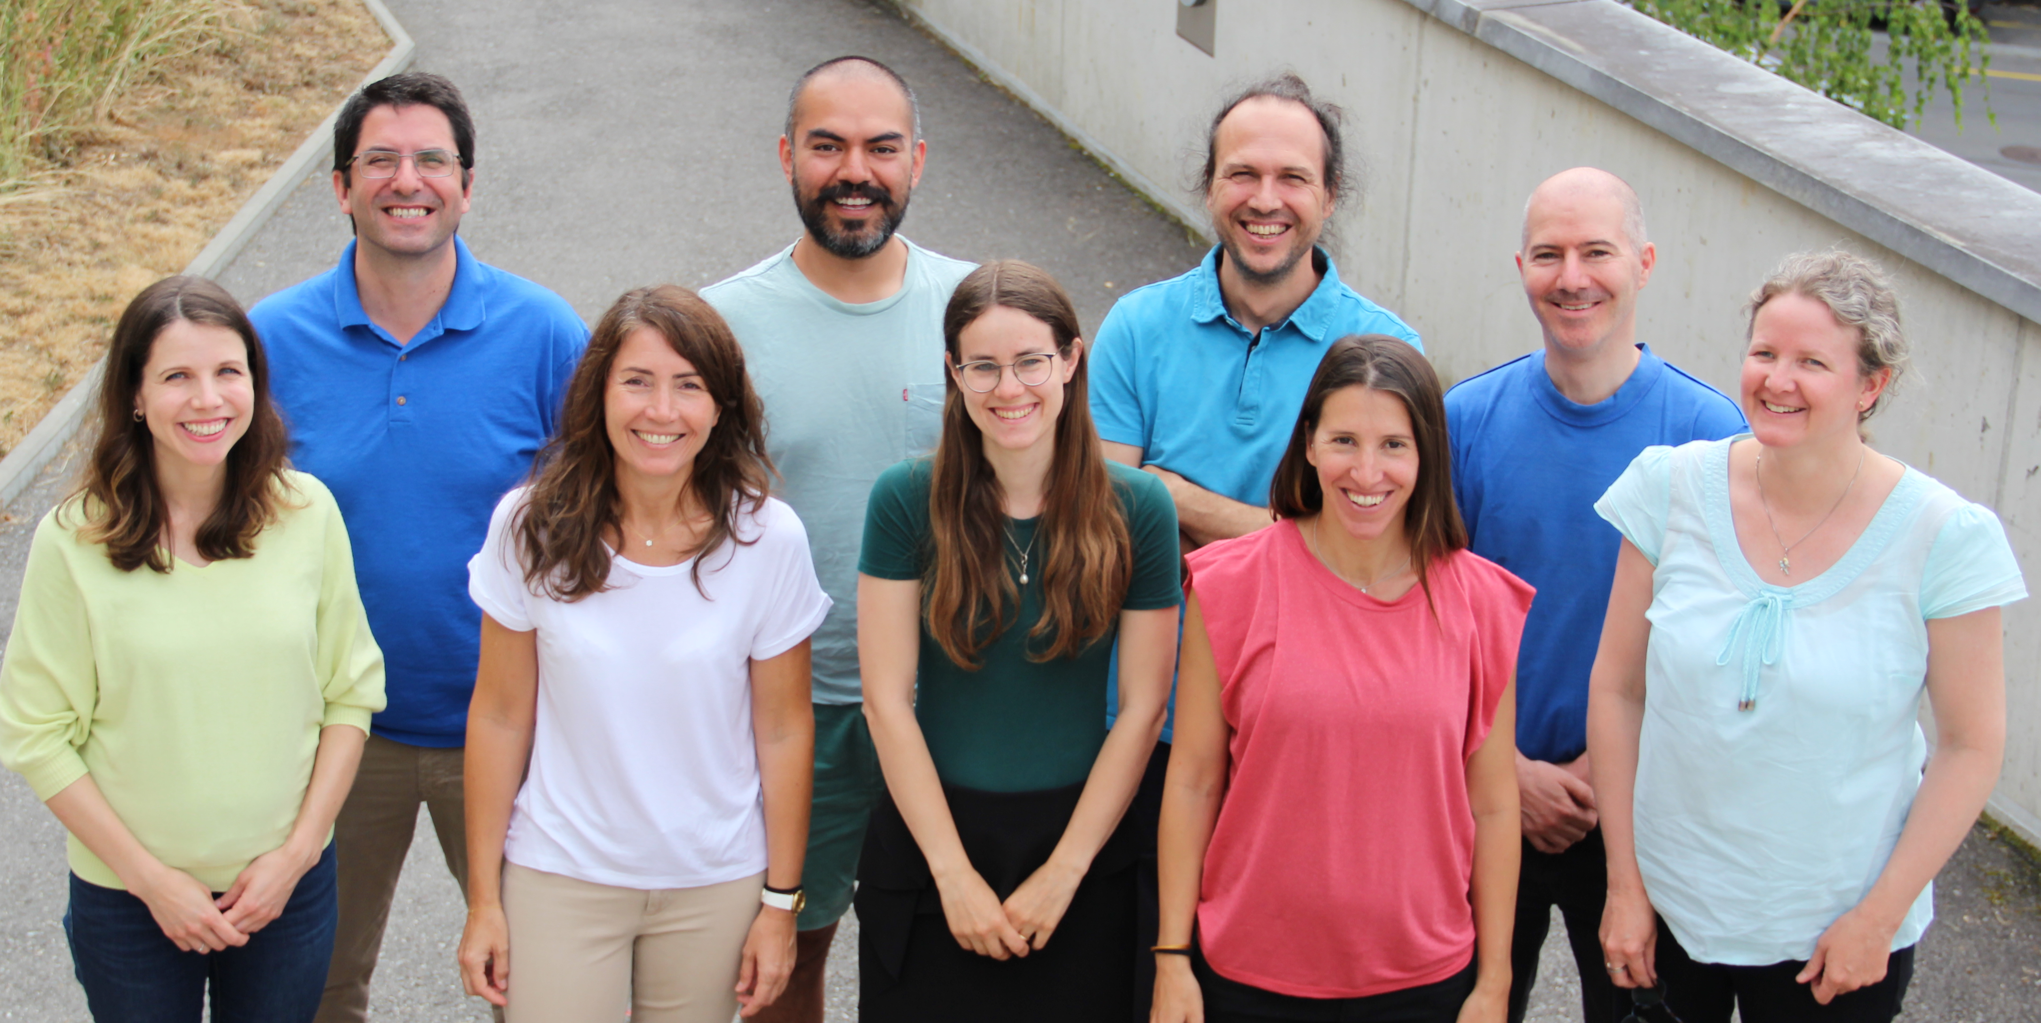
The Translational Data Science group
Part of the SIB Swiss Institute of Bioinformatics
Located at the AGORA Cancer Research Center in Lausanne
Provides the statistics, bioinformatics and computational expertise to molecular biology and applied research labs.
Participates in fundamental and translational research by providing expertise in data analysis of single-cell and bulk multi-omics, spatial transcriptomics, flow cytometry, etc
For core facility service inquiry: nadine.fournier@sib.swiss
https://agora-cancer.ch/scientific-platforms/translational-data-science-facility/
https://www.sib.swiss/raphael-gottardo-group
Notes:
The Translational Data Science (TDS) group focuses on developing novel computational tools, statistical methods and machine learning algorithms for the analysis of high-throughput and high-dimensional datasets generated by novel assay technologies with applications in immunology, vaccine research and immunotherapy. We collaborate with multiple research groups locally, nationally and internationally to address important immunological problems through high-dimensional modeling and data integration.

Slide 4

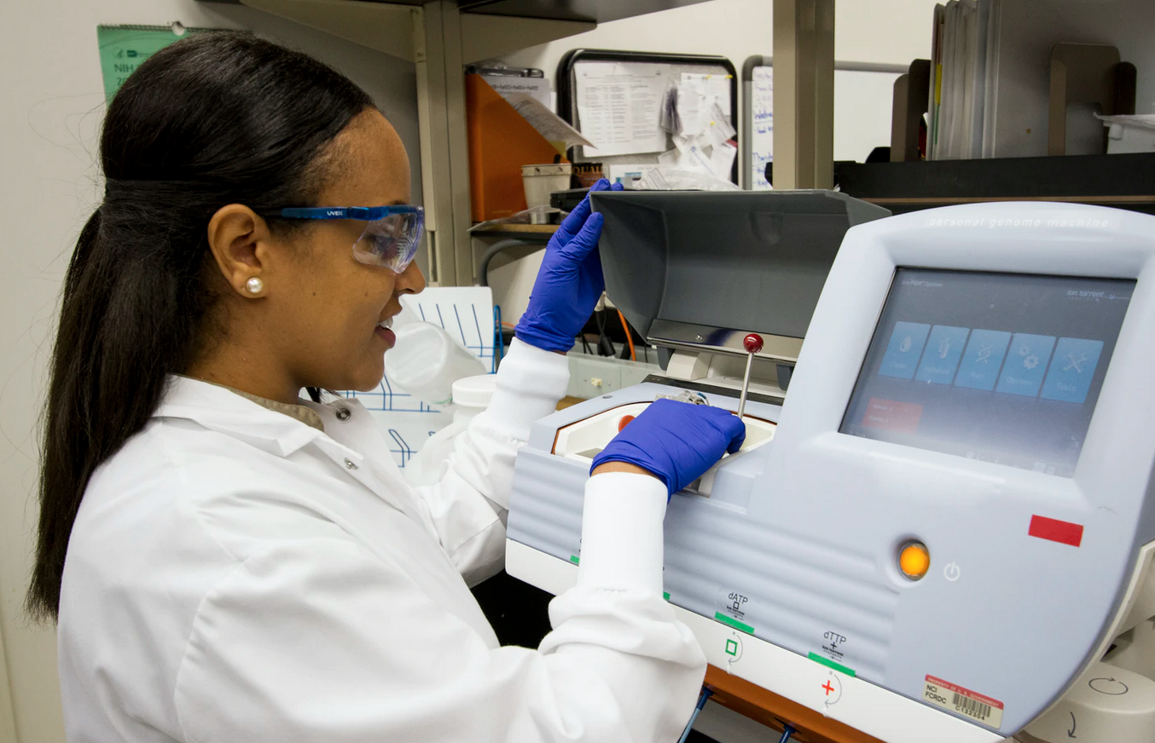

Tell us about yourself !
Write your name and some keywords about yourself and/or your research into the shared doc, to share about yourself.
poll
Photo by National Cancer Institute, Unsplash
Photo by Scott Graham, Unsplash

Slide 5
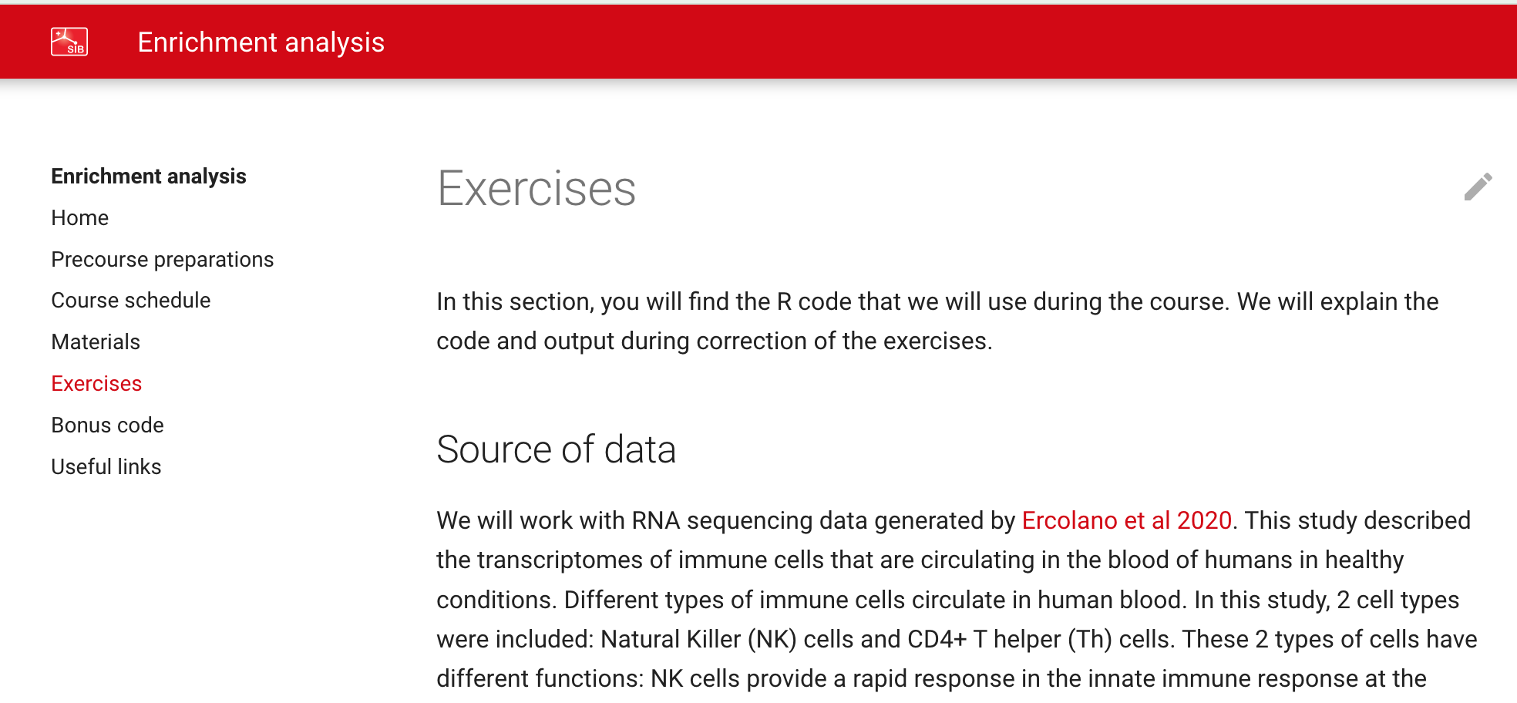
Course material
https://sib-swiss.github.io/enrichment-analysis-training/
Feedback: survey at the end of the day about your opinion on this course (link sent by course organizer).

Slide 6
Credits: 0.25 ECTS
Please provide answers and R code for an additional exercise (eg 1 Word with answers and figures and 1 script file, or 1 file generated using Rmarkdown)
https://sib-swiss.github.io/enrichment-analysis-training/exercises/#extra-exercise-for-ects-credits
Sign up for credit by adding your name to the shared doc file
Send answers to tania.wyss@sib.swiss within 1 week

Slide 7


Questions and Exercises
Feel free to interrupt with questions by asking them directly or raising your (virtual) hand.
Use the Q&A in shared doc (or Zoom chat), we will provide answers
Add a when you are done with the current exercise
Exercises in R:
We will try to debug as much as possible
We are happy if you share your results or alternative code!

Slide 8
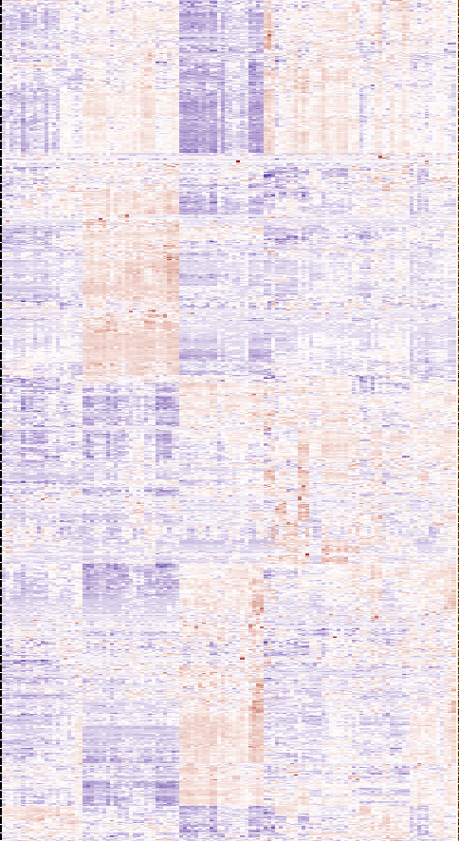
Why do we perform enrichment analysis?
Some genes have similar
expression pattern across samples
Gene expression analysis yields hundreds to thousands of significant genes
We need to summarize the information provided by so many genes
Understand their biological relationships
Understand the genes’ function (functional analysis)
Identify overarching biological processes or molecular pathways taking place in your system
IVY GAP: https://glioblastoma.alleninstitute.org/
Notes:
Interpret the expression results in terms of higher order biological processes or molecular pathways

Slide 9
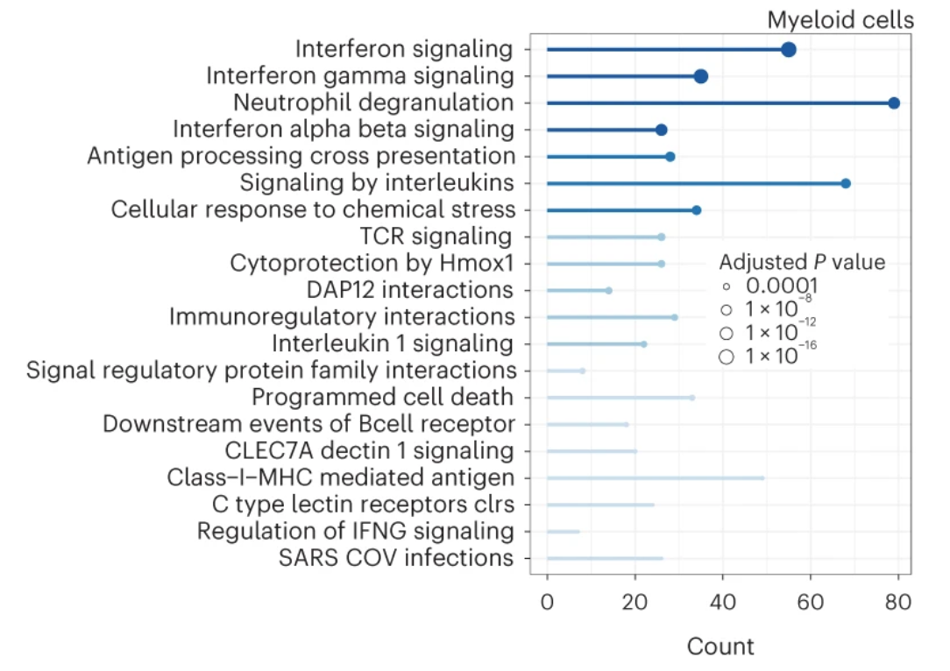
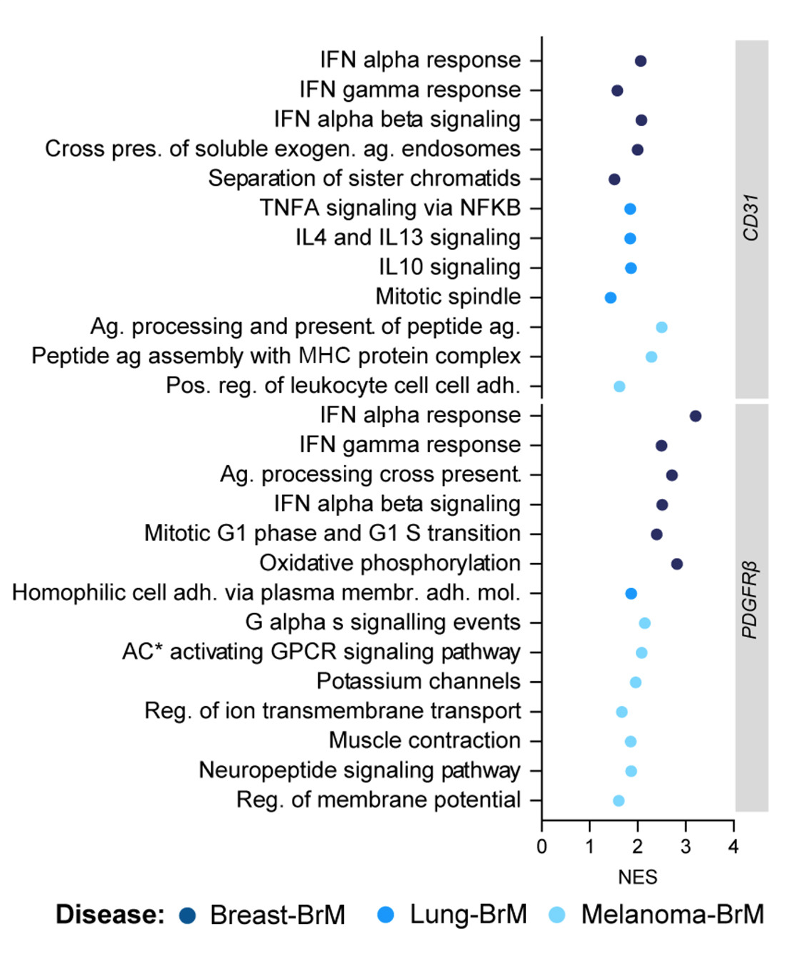
Enrichment analysis in the literature – non-exhaustive examples
Often presented in omics studies
Different molecular alterations in vasculature of brain metastasis from different origins, compared to normal brain vasculature
Impact of a treatment on myeloid cells,
pathways that could contribute to tumor growth limitation
Bulk RNAseq (GSEA)
https://doi.org/10.1016/j.ccell.2023.12.018
Single-cell RNAseq (ORA)
https://doi.org/10.1038/s43018-023-00668-y
Notes:
Annamaria: Brain metastasis ECs, jan 2024
https://www.cell.com/cancer-cell/fulltext/S1535-6108(23)00446-4#secsectitle0015
Rachel: DCs, Nov 2023
https://www.nature.com/articles/s43018-023-00668-y

Slide 10
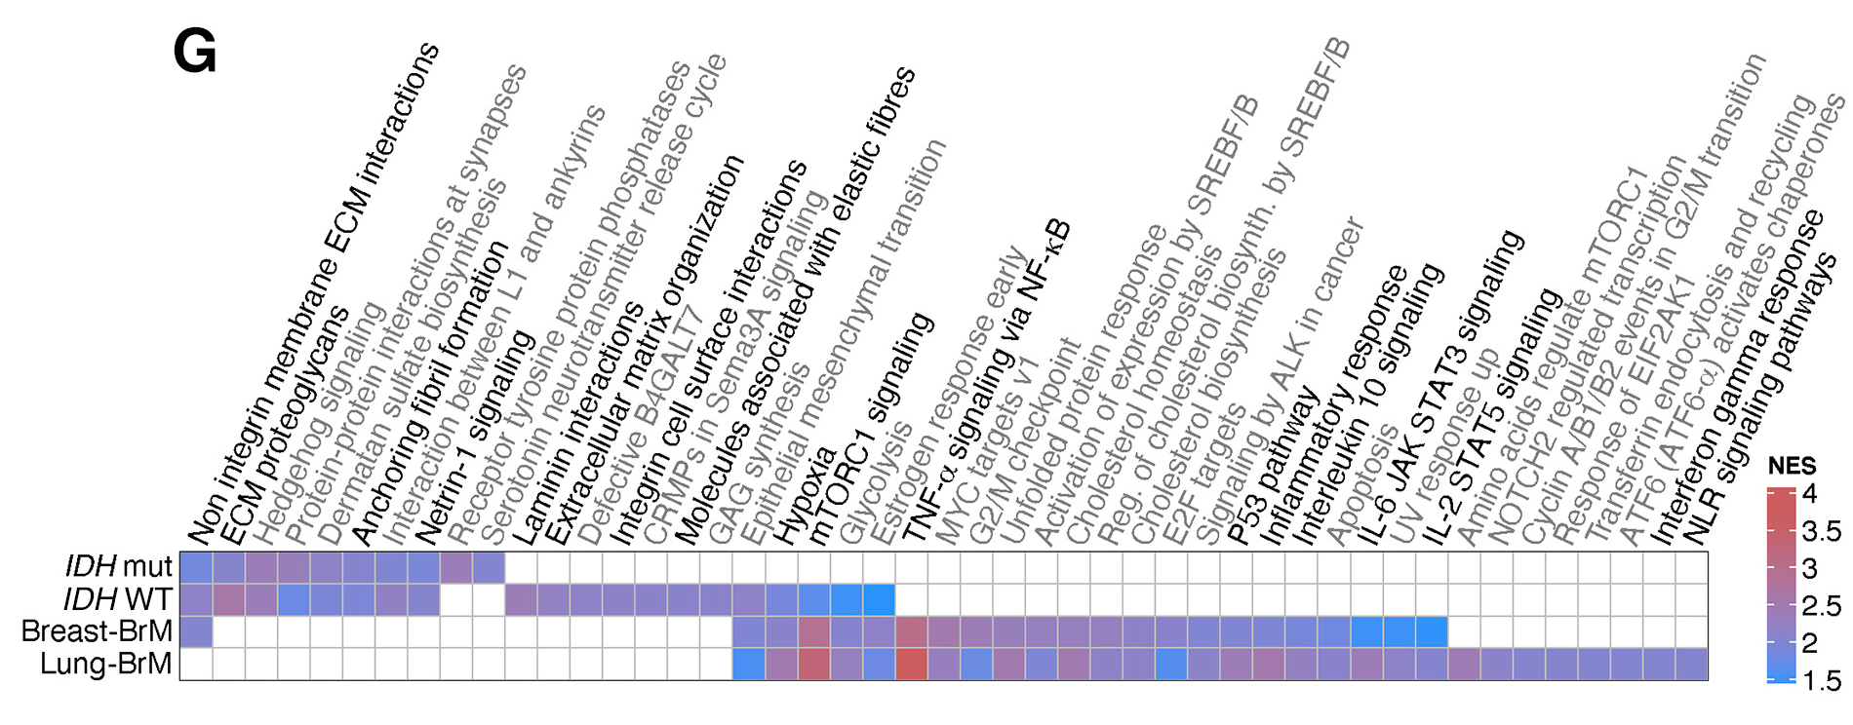
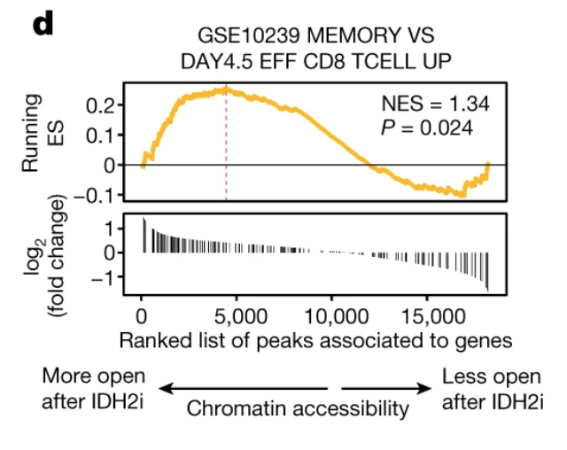
Enrichment analysis in the literature – non-exhaustive examples
Neutrophils (immune cells) express different pathways depending on the brain tumor genotype (mut/WT) or origin (primary vs metastatic tumor)
Bulk RNAseq (GSEA)
https://doi.org/10.1016/j.cell.2023.08.043
Increased memory phenotype in immune cells exposed to a component.
Bulk ATACseq (GSEA)
https://doi.org/10.1038/s41586-023-06546-y
Notes:
Joao: heatmap of NES:
https://www.cell.com/cell/fulltext/S0092-8674(23)00977-7
Jaccard IDH2i vs control: more memory phenotype
https://www.nature.com/articles/s41586-023-06546-y/figures/3

Slide 11
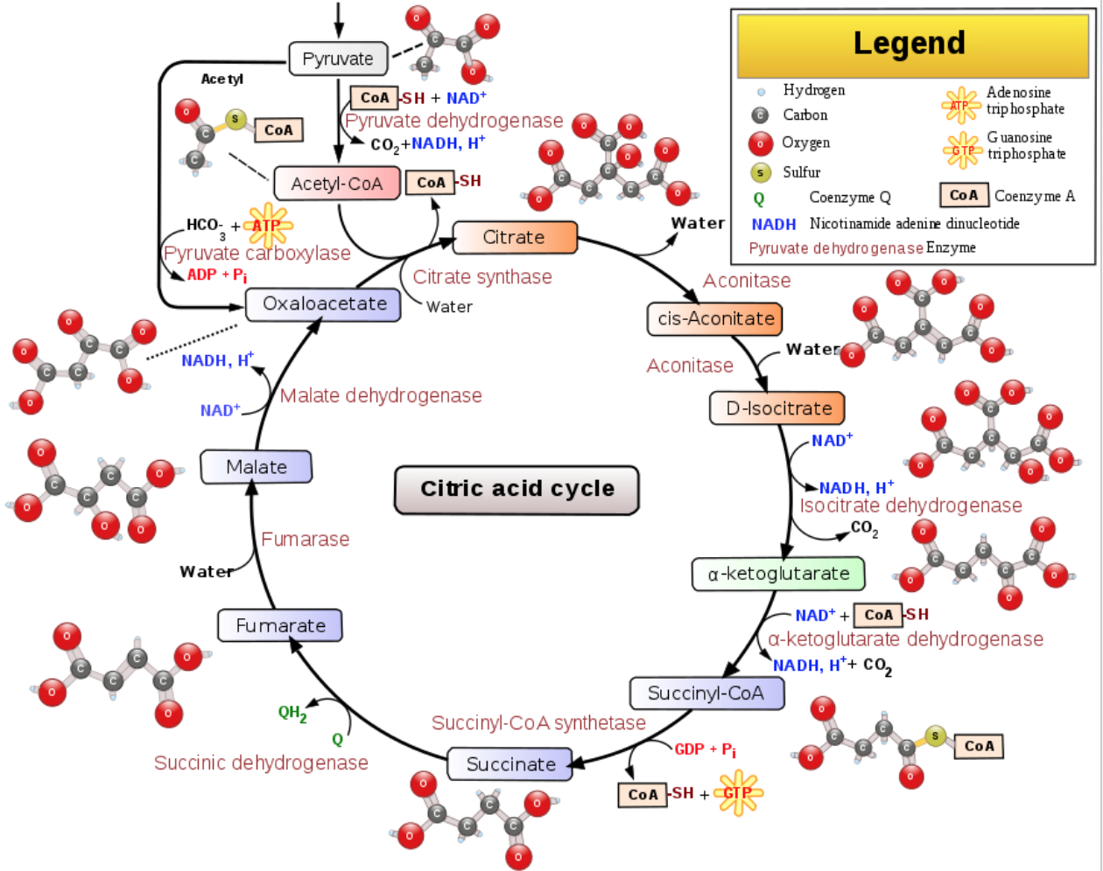
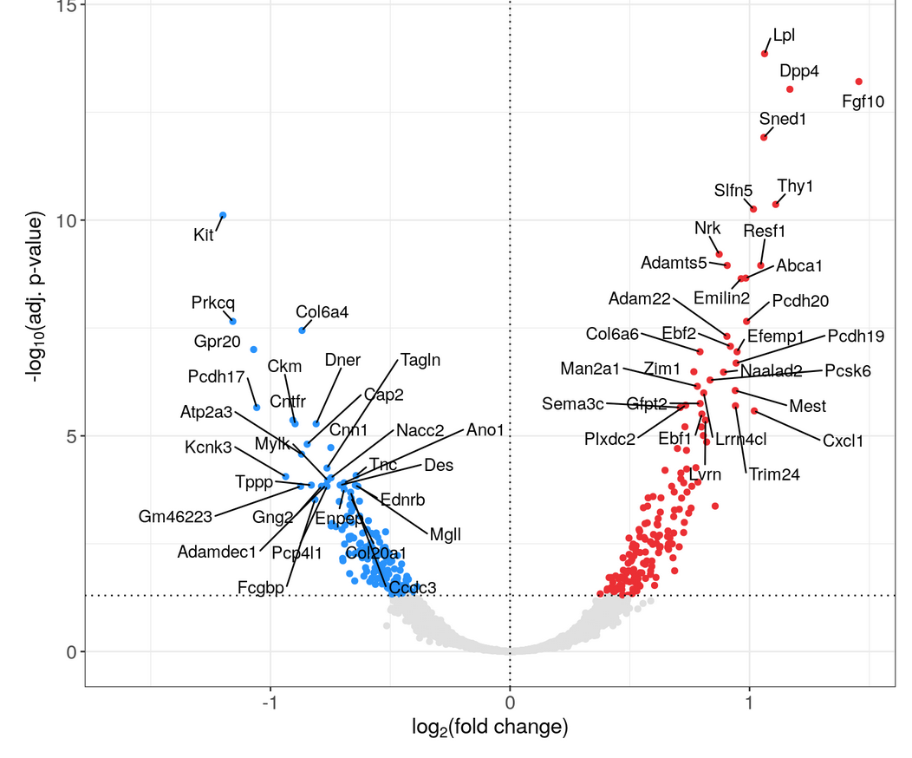
Enrichment analysis – input data
List of genes/proteins that are:
Database of gene/protein functional annotation
Differentially expressed between 2 conditions
Similar expression pattern across samples
…
Either available as a list of gene symbols/IDs or with a score associated to each gene: e.g. T statistic or fold change
Genes need to be grouped into gene sets/pathways/functional annotations.
Consortia of researchers usually create these gene groupings/annotations
https://en.wikipedia.org/wiki/Citric_acid_cycle

Slide 12
Enrichment analysis - three major steps
Obtain a gene/protein list from omics data
Apply statistical methods to identify pathways enriched in the gene list relative to what is expected by chance
Visualize and interpret the results
List of genes of interest
Statistical methods to
determine enriched pathways
Create figures
Notes:
https://www.nature.com/articles/s41596-018-0103-9
Interpret in-tur-prit

Slide 13
Enrichment analysis in non-model organisms
Need functional annotation of genes: genes need to be grouped into pathways/functions.
If not available, convert your genes into the orthologs of a closely related species that has such a database.
Will require effort to find a gene functional annotation database. All statistical analyses are otherwise the same.
See Useful links:
https://sib-swiss.github.io/enrichment-analysis-training/links/#tools-for-species-other-than-human-or-mouse

Slide 14
Approaches used in enrichment analysis
Test your gene list for enrichment of:
Genes associated with a particular function or pathway (targeted)
Genes annotated into a large collection of gene sets (exploratory)
Statistical methods available (covered today):
over-representation analysis (ORA)
gene set enrichment analysis (GSEA)

Slide 15
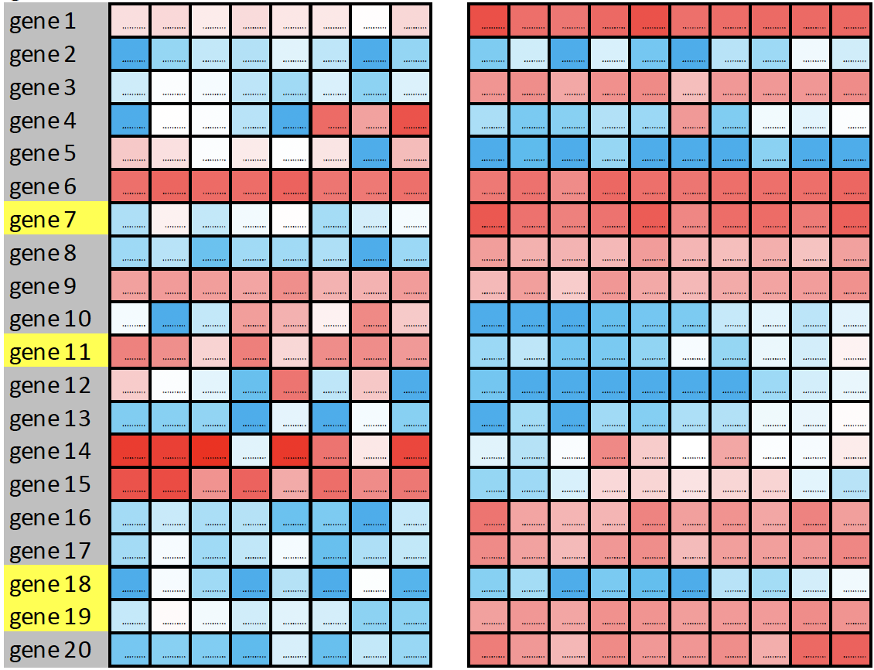
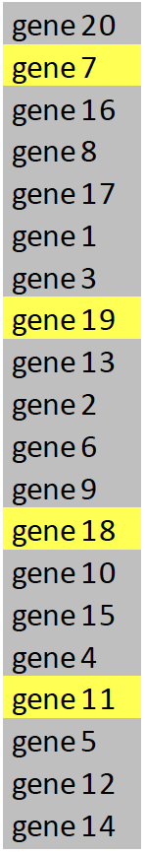
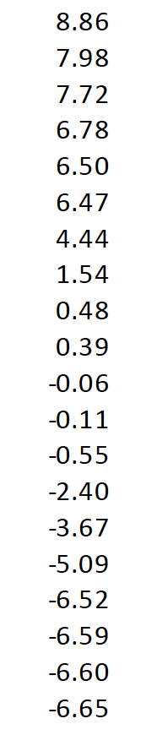
Over-representation analysis (ORA)
Are the DE genes overlapping with the genes contained within the yellow set?
healthy donors
patients
sort based
on T-statistic or
fold change
and count
significant genes
based on p-value
Up-regulated
& p<0.05
Not diff.
expressed
Down-regulated
& p<0.05

Slide 16
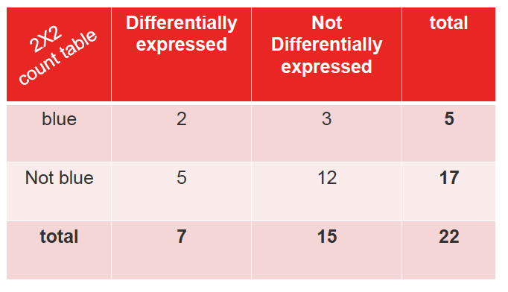
Fisher’s exact test
2 x 2 count table | Up-regulated | Not up-regulated | Total
Yellow | 2 | 2 | 4
Not yellow | 6 | 9 | 15
Total | 8 | 11 | 19
contingency table
H₀: The proportion of yellow genes up-regulated is the same as the proportion of yellow genes that are not up-regulated.
H₁: The proportion of yellow genes up-regulated is not the same as the proportion of yellow genes that are not up-regulated.
http://mengnote.blogspot.com/2012/12/calculate-correct-hypergeometric-p.html
Notes:
Association between 2 categorical variables: i.e. number of differentially expressed genes and number of yellow genes

Slide 17
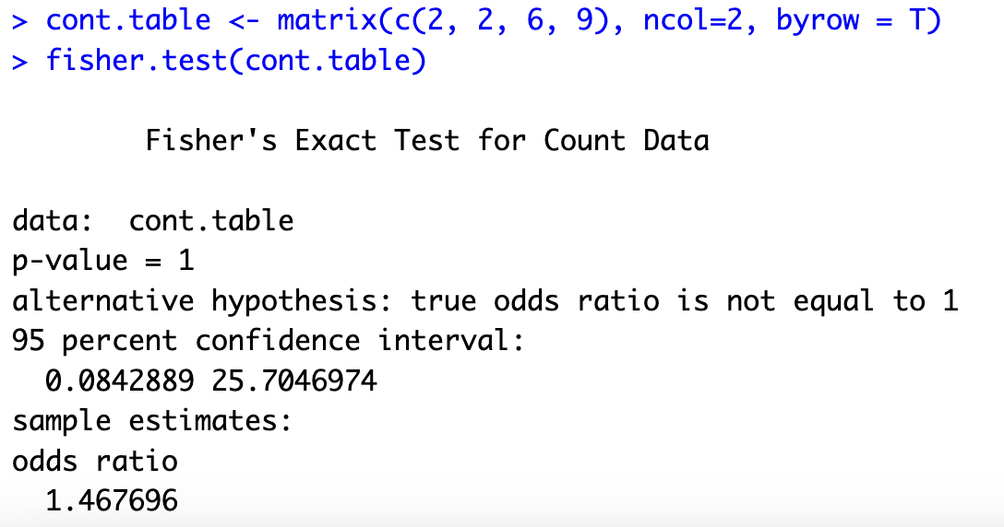
Fisher’s exact test in R
2 x 2 count table | Up-regulated | Not up-regulated | Total
Yellow | 2 | 2 | 4
Not yellow | 6 | 9 | 15
Total | 8 | 11 | 19
2/8 =
0.25
2/12 =
0.167

Slide 18
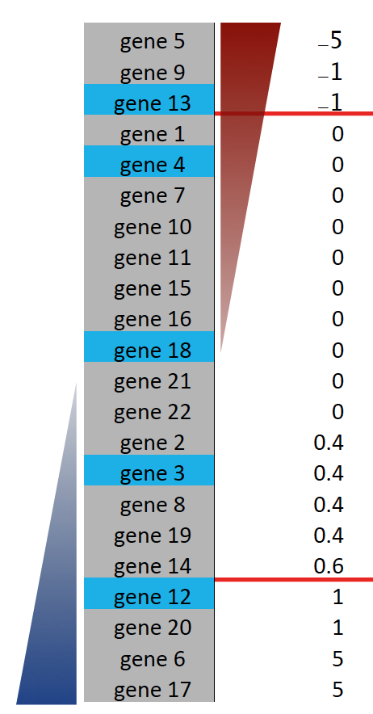
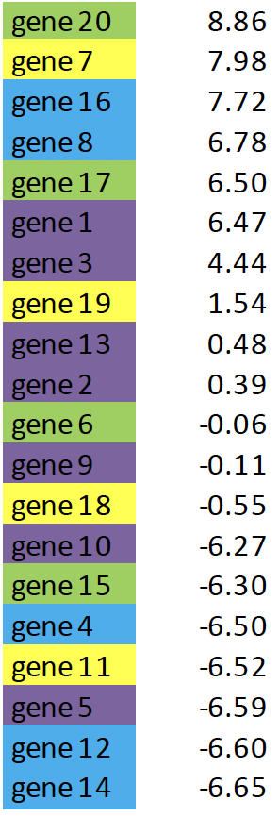
Which gene sets are differentially expressed?
Run individual Fisher’s exact tests for each gene set, yellow, blue, purple, green
Multiple tests need p-value adjustment.
Up-regulated
& p<0.05
Not diff.
expressed
Down-regulated
& p<0.05

Slide 19
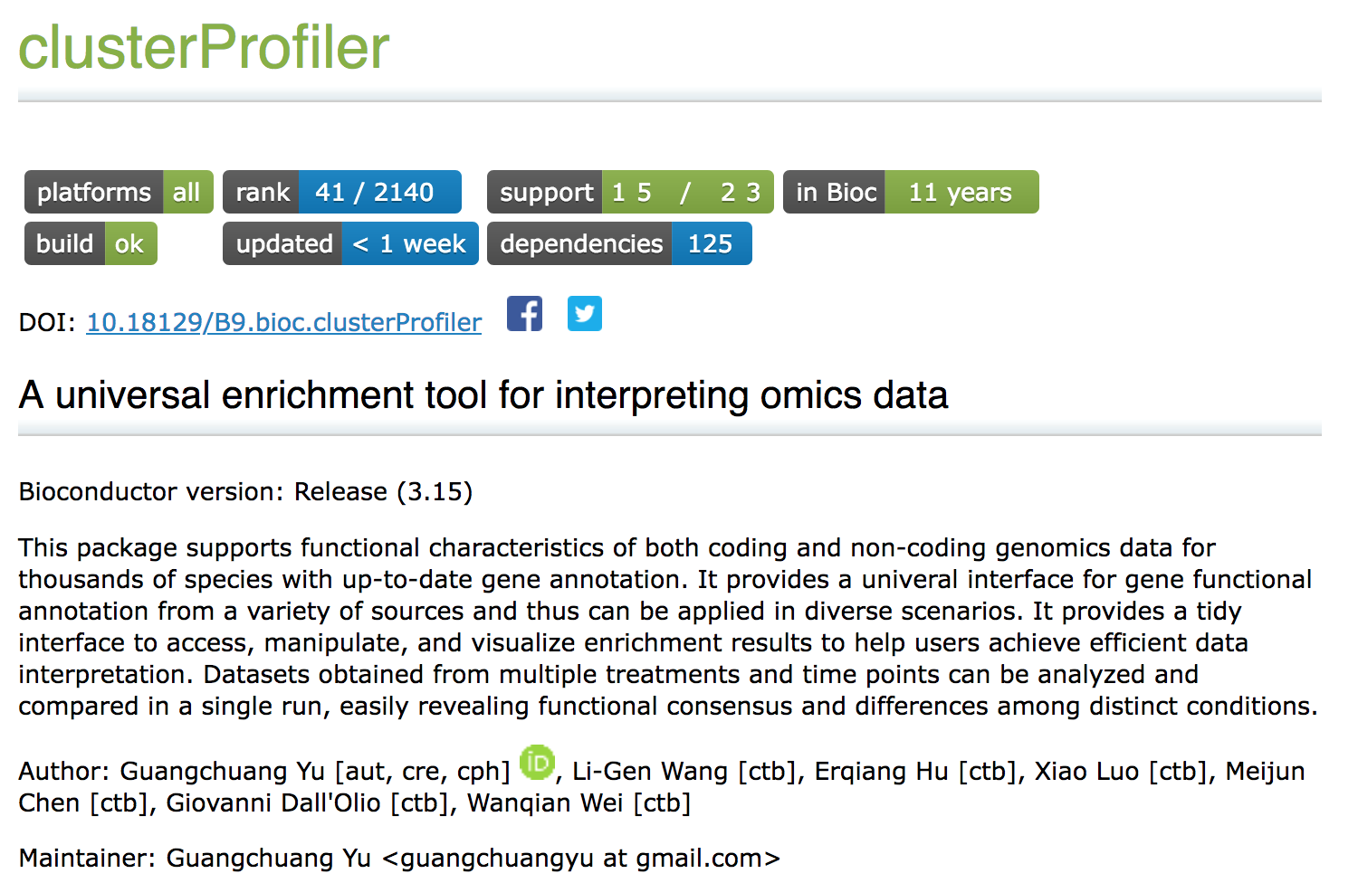
Enrichment analysis using R: one possibility among others
Built-in functions for enrichment analysis
Built-in gene sets for human, mouse, yeast, etc
Built-in GO and KEGG (see later)
https://bioconductor.org/packages/release/bioc/html/clusterProfiler.html
G Yu, LG Wang, Y Han, QY He. clusterProfiler: an R package for comparing biological themes among gene clusters. OMICS: A Journal of Integrative Biology 2012, 16(5):284-287. doi:[10.1089/omi.2011.0118](http://dx.doi.org/10.1089/omi.2011.0118)
Full vignette: http://yulab-smu.top/clusterProfiler-book/

Slide 20
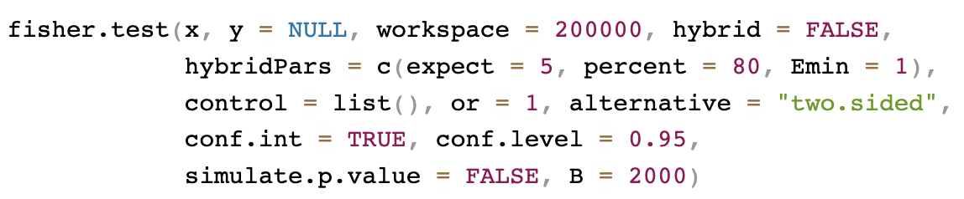
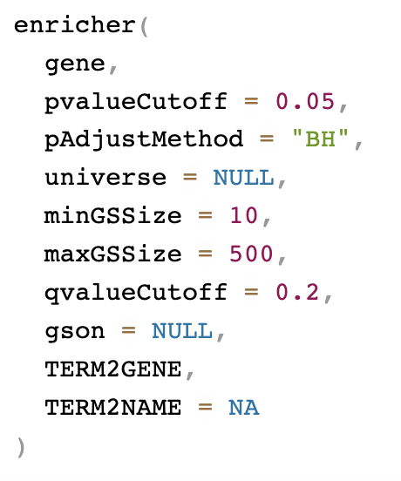
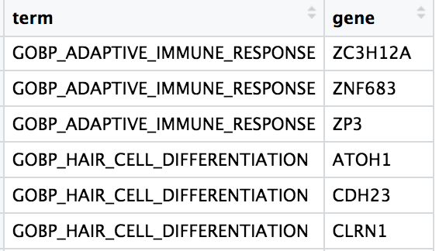
Functions for Fisher test and for ORA with R and clusterProfiler
Fisher exact test (package stats)
enricher(): implementation of hypergeometric test (one-sided Fisher test)
for user defined gene list and gene set collections (package clusterProfiler)
TERM2GENE:
A 2-column
data frame
Eg genes that are markers of cell
clusters of single-cell RNA seq
Notes:
Needs more than 1 gene set

Slide 21


Slide 22
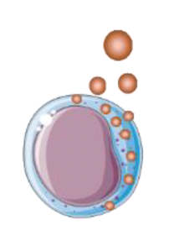
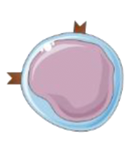
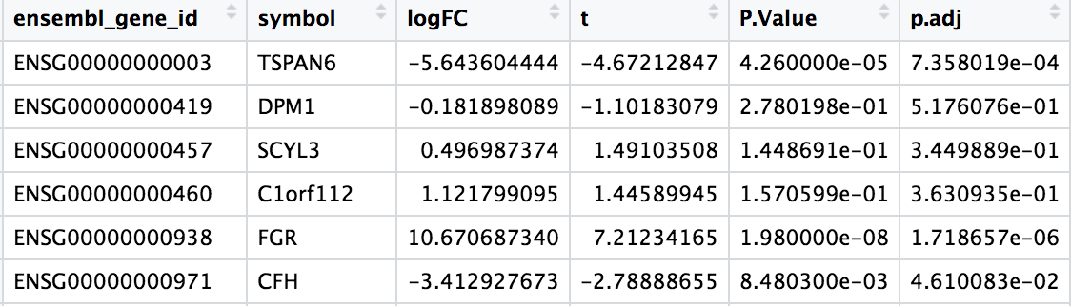
Recap and exercise 1
Innate immunity
Adaptive immunity
NK
Th
https://www.mdpi.com/1420-3049/24/24/4530/htm
Once we have identified differentially expressed (DE) genes, we can use an over-representation analysis to determine whether or not the genes of a gene set of interest are over-represented among the DE genes or not.
Exercise 1:
Results table of differential gene expression analysis between 2 human immune cell types, natural killer (NK) cells and CD4 T helper cells (Th):
Run a Fisher’s exact test to determine whether genes involved in the adaptive immune response are over-represented among the genes up-regulated in Th cells.
Positive logFC = higher in NK
Negative logFC = lower in NK
RNA sequencing data from:
https://jlb.onlinelibrary.wiley.com/doi/full/10.1002/JLB.5MA0120-209R?af=R
https://ashpublications.org/bloodadvances/article/3/22/3674/428873/CD56-as-a-marker-of-an-ILC1-like-population-with

Slide 23
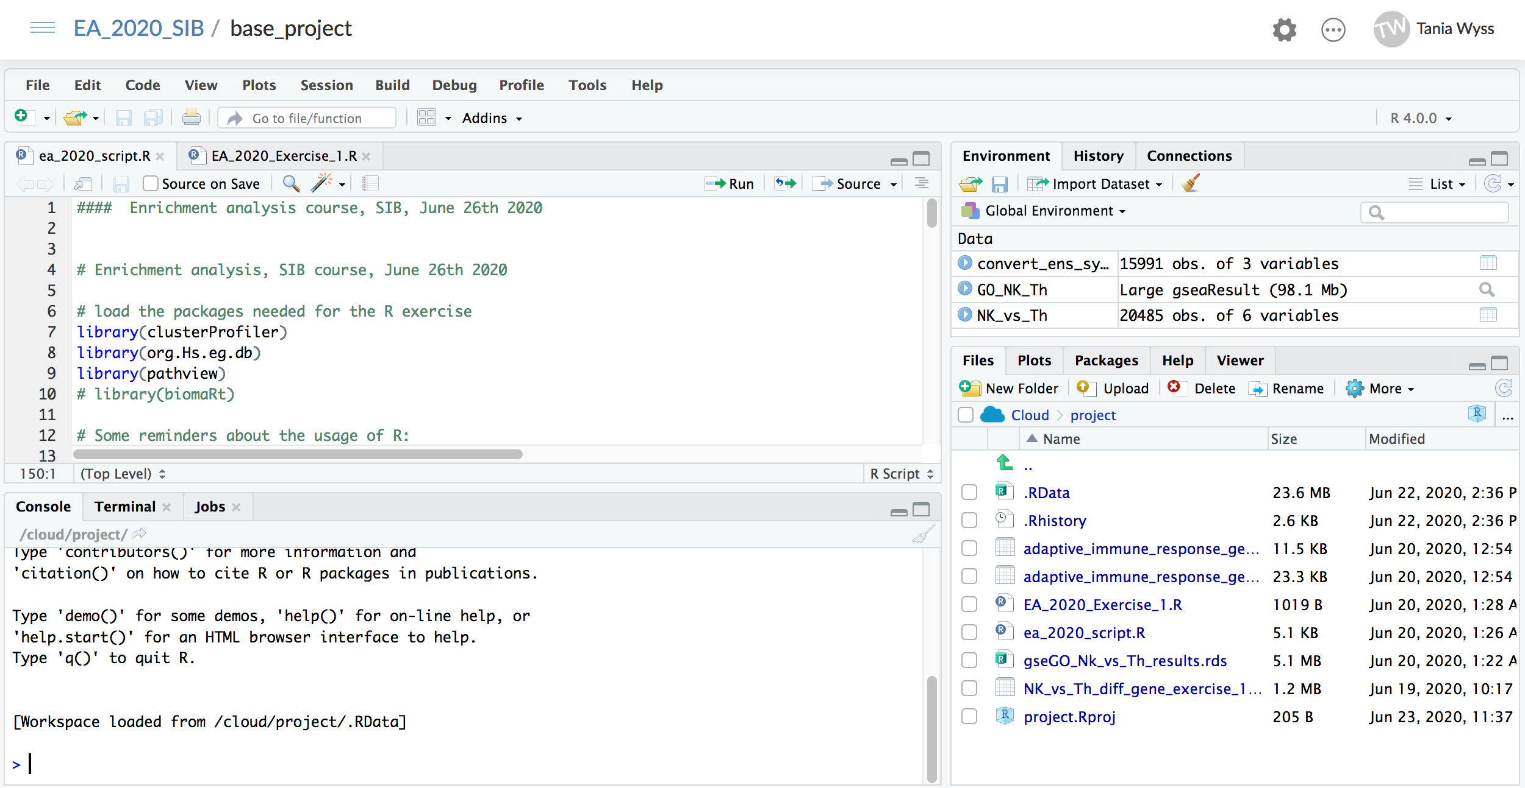
RStudio tour

Slide 24
Fisher’s exact test is threshold-based
2 x 2 count table | Up-regulated | Not up-regulated | Total
Yellow | 2 | 2 | 4
Not yellow | 6 | 9 | 15
Total | 8 | 11 | 19
Contingency table with count of genes,
does not take into account the magnitude
of the change of each gene.
http://mengnote.blogspot.com/2012/12/calculate-correct-hypergeometric-p.html

Slide 25
Gene set enrichment analysis (GSEA)
Threshold-free: the whole list of genes detected in the omics data is used.
GSEA is a computational method that determines whether an a priori defined set of genes shows statistically significant, concordant differences between two biological states (MSigDB)
Rank all genes based on score (eg t-statistic) and calculate an enrichment score (ES) that reflects the degree to which the members of a gene set are overrepresented at the top or bottom of the ranked genes.
Subramanian et al PNAS 2005. Gene set enrichment analysis: A knowledge-based approach for interpreting genome-wide expression profiles

Slide 26
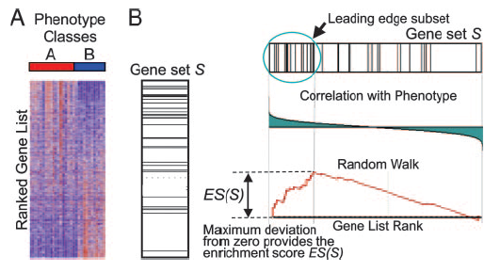
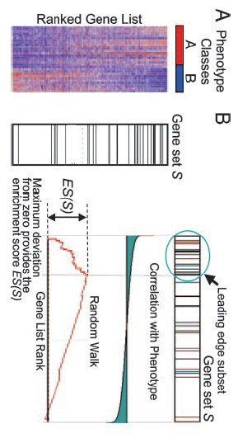
Method of GSEA
Goal: determine whether the members of a gene set S are randomly distributed throughout a ranked gene list or if they are located at the top or bottom of the ranked gene lists
1.
Sort the genes based on the t statistic (=weight)
1.
1.
-15 0 +15
t statistic
Subramanian et al PNAS 2005. Gene set enrichment analysis: A knowledge-based approach for interpreting genome-wide expression profiles

Slide 27
Method of GSEA
1.
1.
1.
1.
Sort the genes based on the t statistic (=weight)
Calculate enrichment score ES using weight. The ES for a set is the maximum value reached (pos. or neg.)
For ES equation, see Appendix in Subramanian et al 2005: https://www.pnas.org/doi/epdf/10.1073/pnas.0506580102

Slide 28
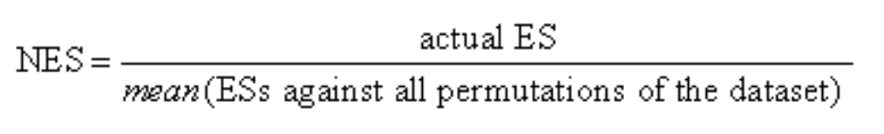
Method of GSEA
Sort the genes based on the t statistic (=weight)
Calculate enrichment score ES using weight. The ES for a set is the maximum value reached (pos. or neg.)
Perform permutations of samples and/or genes to recalculate random ES scores
Calculate Normalized ES (NES) and estimate p-value of each gene set based on randomized ES scores
Adjust p-value
Do not forget p-value adjustment if more than 1 gene set is tested!
NES: 1
p: 0.5
NES: 1.16
p: 0.05
NES: 1.32
p: 0.001

Slide 29
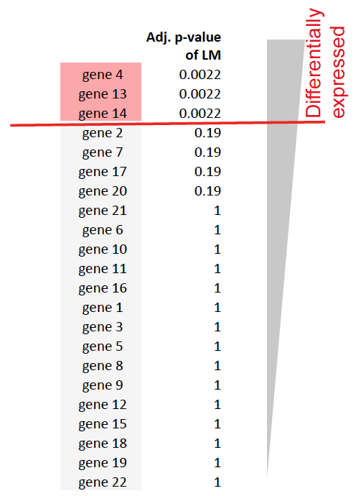
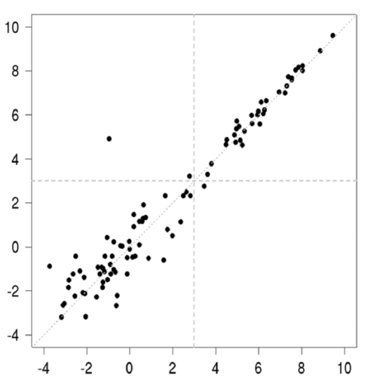
Apply GSEA to other type of data or score
Use t-statistic from paired t-test
Use F statistic of one way or two way ANOVA
Use coefficients of linear model
GSEA for linear model
implemented in romer()
function of the limma
package
gene expression level
coagulation

Slide 30
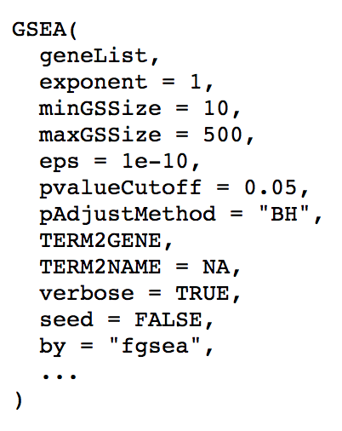
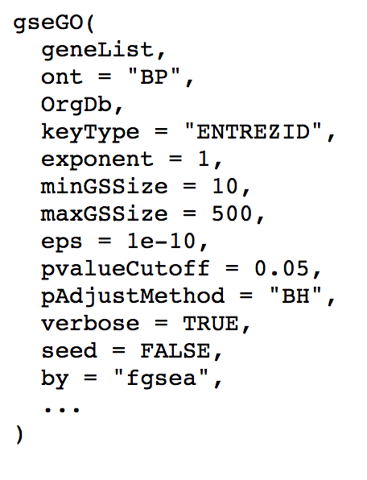
Functions for GSEA with clusterProfiler
GSEA(): GSEA of user-defined gene sets using
all ranked genes
gseGO(): GSEA of GO gene sets using
all ranked genes

Slide 31
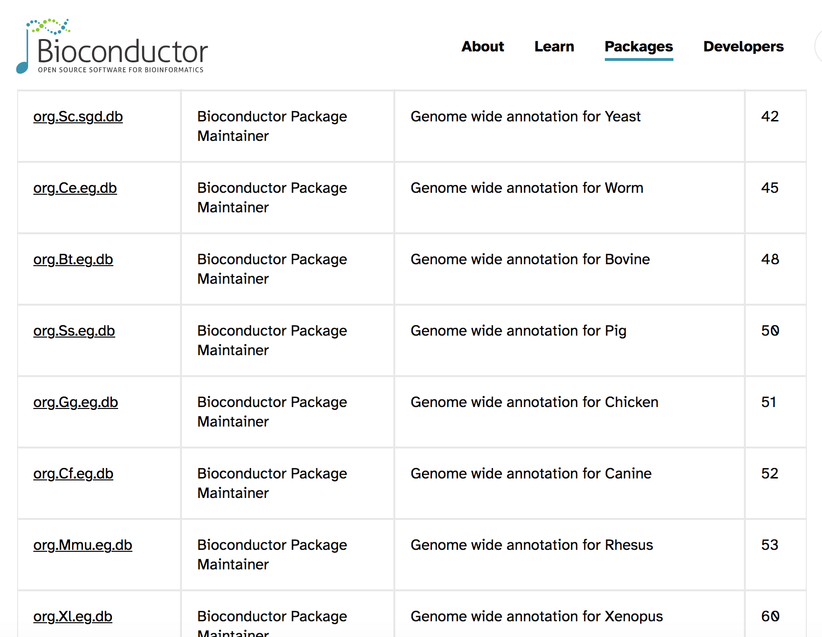
Bioconductor orgDb packages
https://bioconductor.org/packages/3.18/BiocViews.html#___OrgDb
Notes:
https://bioconductor.org/packages/3.18/BiocViews.html#___OrgDb

Slide 33
Recap and exercise 2
Fisher test is a threshold-based method, while GSEA is a threshold-free enrichment method. Both can be used for single or multiple gene sets.
Exercise 2: use functions of clusterProfiler and data provided in Ex. 1
Run a GSEA for the Gene Ontology gene sets (more details on this collection later)
Explore the results: how many gene sets are significant? Are the gene sets up-regulated or down-regulated in NK cells?

Slide 34
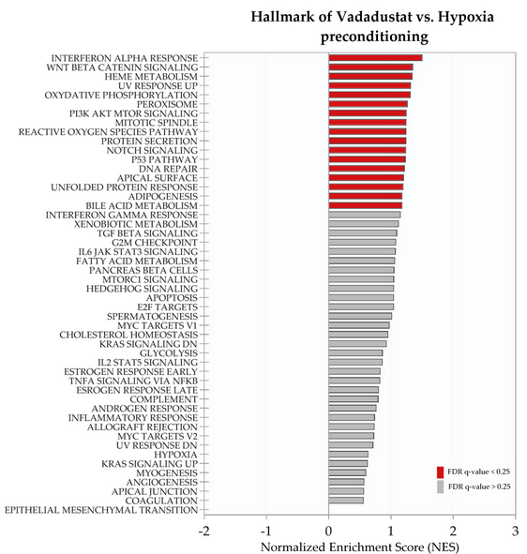
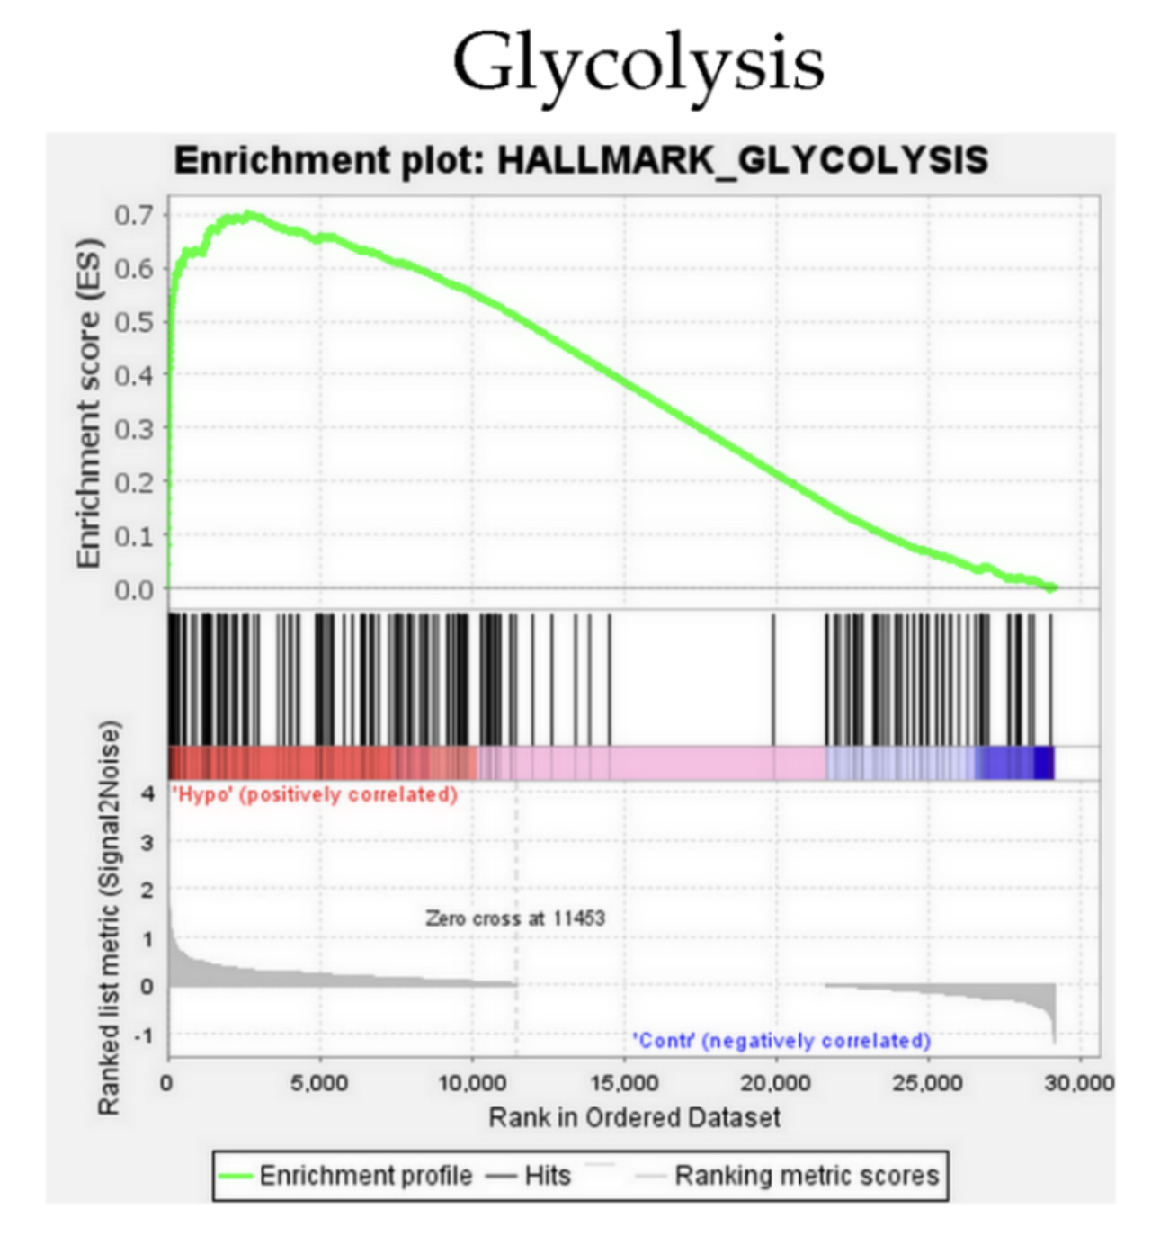
Visualization of enrichment results
There are many options, here some common ones:
Barplot of NES for many pathways:
GSEA plot for a single pathway:
Zielniok et al 2021
Int. J. Mol. Sci. 2021, 22(15), 8160; https://doi.org/10.3390/ijms22158160
Via enrichplot: package for visualization using clusterProfiler objects
https://www.bioconductor.org/packages/release/bioc/html/enrichplot.html

Slide 35
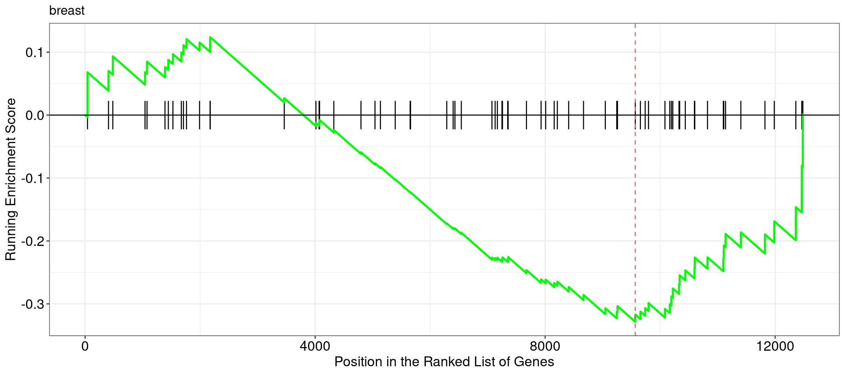
Visualizations available in clusterProfiler
GSEA plot (or barcode plot; for gseaResult objects)
> gseaplot(h_NK_vs_Th, geneSetID = “breast", title=" breast")
Notes:
Running score and preranked list are traditional methods for visualizing GSEA result. The enrichplot package supports both of them to visualize the distribution of the gene set and the enrichment score.

Slide 36
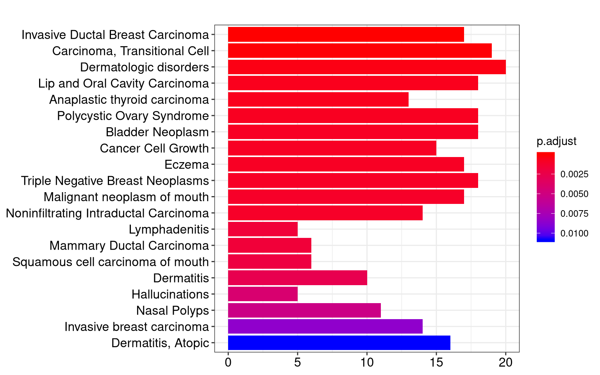
Visualizations available in clusterProfiler
barplot (from graphics package but works on enrichResult objects)
> ego <- enrichGO(de, OrgDb=org.Hs.eg.db, ont="BP", keyType = "SYMBOL")
> barplot(ego, showCategory=20)
Notes:
Bar plot is the most widely used method to visualize enriched terms. It depicts the enrichment scores (e.g. p values) and gene count or ratio as bar height and color. Barplot function can be used directly on enrichResult object (not on gseaResult object)

Slide 37
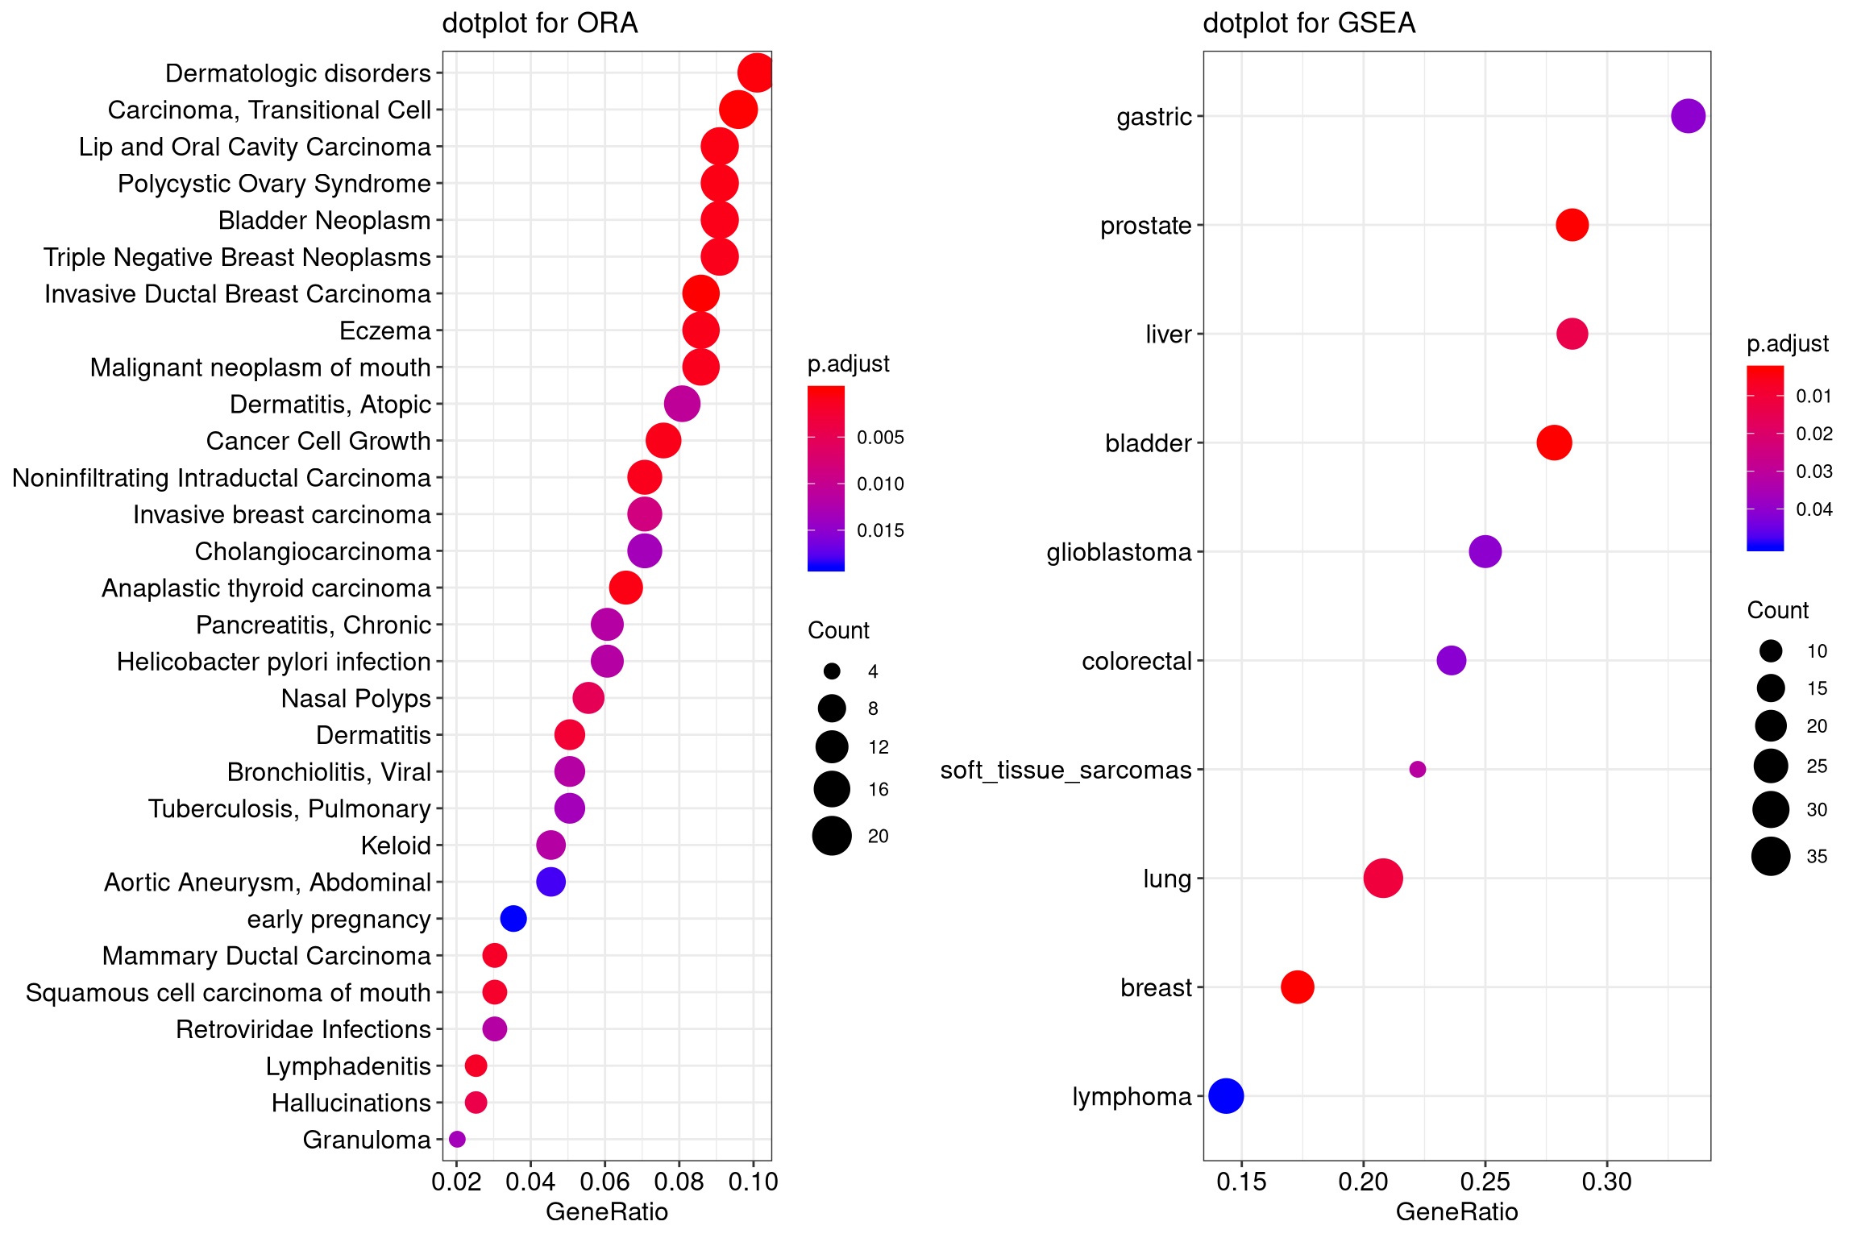
Visualizations available in clusterProfiler
> ego <- enrichGO(de)
> dotplot(ego, showCategory=20)
dotplot
Notes:
Dot plot is similar to bar plot with the capability to encode another score as dot size.

Slide 38
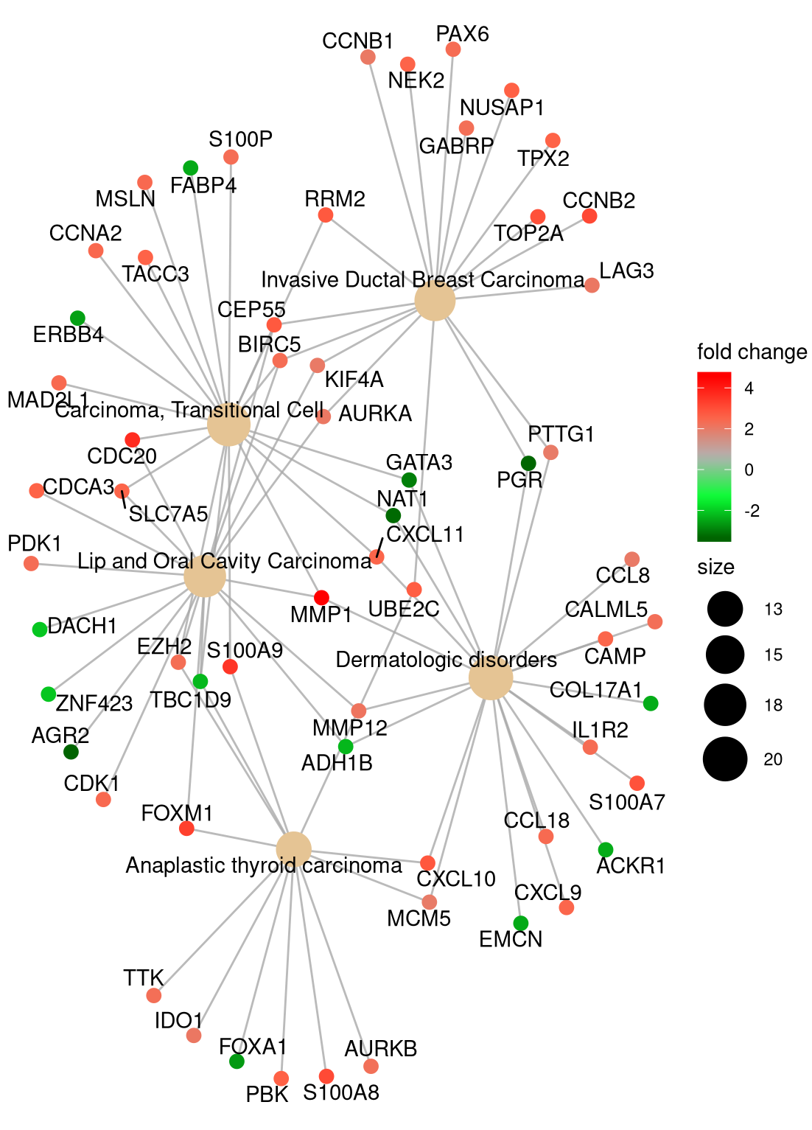
Visualizations available in clusterProfiler
> cnetplot(ego, categorySize="pvalue", foldChange=geneList)
Gene-concept network
Notes:
Both the barplot and dotplot only display most significant enriched terms, while users may want to know which genes are involved in these significant terms. In order to consider the potentially biological complexities in which a gene may belong to multiple annotation categories and provide information of numeric changes if available, we developed cnetplot function to extract the complex association. The cnetplot depicts the linkages of genes and biological concepts (e.g. GO terms or KEGG pathways) as a network. GSEA result is also supported with only core enriched genes displayed.

Slide 39
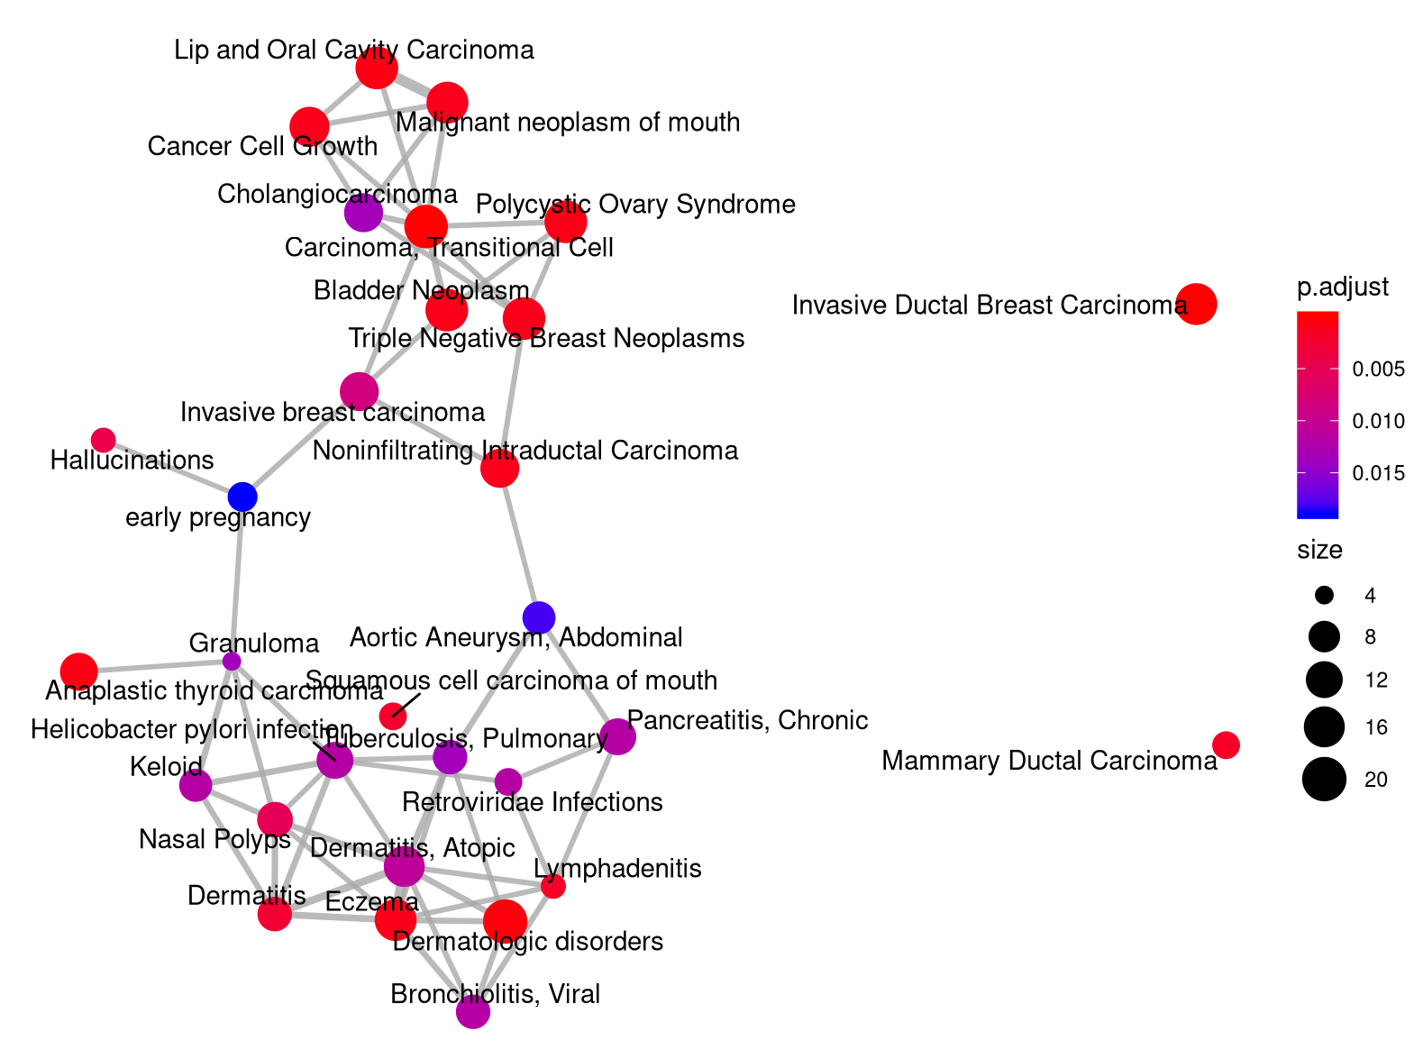
Visualizations available in clusterProfiler
Enrichment map
> ego <- enrichGO(de)
> emapplot(ego)
Notes:
Enrichment map organizes enriched terms into a network with edges connecting overlapping gene sets. In this way, mutually overlapping gene sets cluster together, making it easy to identify functional module.
The emapplot function supports results obtained from hypergeometric test and gene set enrichment analysis. The pie_scale parameter can be used to resize nodes and the layout parameter can adjust the layout.

Slide 40
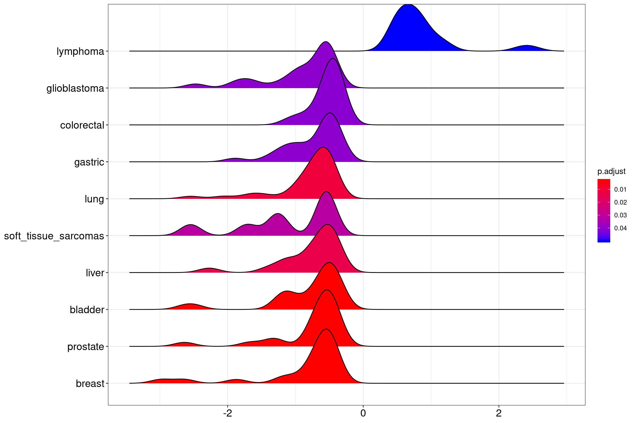
Visualizations available in clusterProfiler
> ego <- gseGO(de)
> ridgeplot(ego)
Ridgeplot
Notes:
The ridgeplot will visualize expression distributions of core enriched genes for GSEA enriched categories. It helps users to interpret up/down-regulated pathways.

Slide 42
Recap and Exercise 3
Several visualization methods can be used to represent the results, either for single gene sets (barcode plot) or for several gene sets (barplots, etc).
Exercise 3: Create figures for the enrichment results:
barplot of –log₁₀(p-value) of the p-values of the top 10 GO gene sets, or of positive and negative NES values
Enrichment maps, gene-concept networks, ridge plots, etc

Slide 43
What is a gene set?
https://en.wikipedia.org/wiki/Citric_acid_cycle
Genes working together in a pathway (e.g. energy release through Krebs cycle)
Genes located in the same compartment in a cell (e.g. all proteins located in the cell nucleus)
Proteins that are all regulated by a same transcription factor
Custom gene list that comes from a publication and that are down-regulated in a mutant
List of SNPs associated with a disease
… etc!
Several gene sets are grouped into Knowledge bases

Slide 44
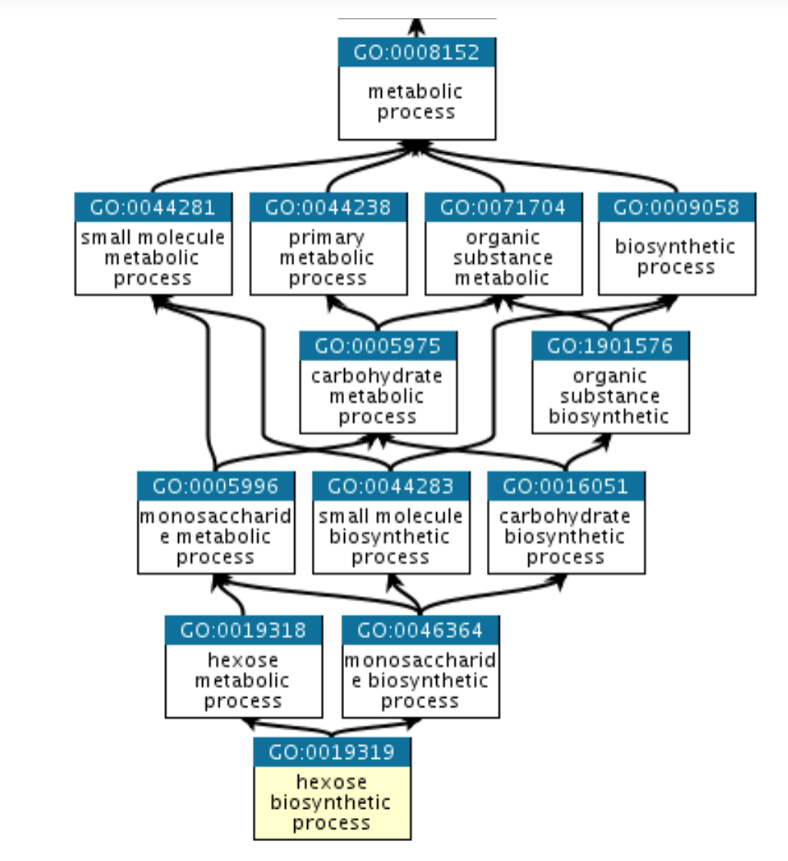
Gene ontology
http://geneontology.org/
Collaborative effort to address the need for
consistent descriptions of gene products
across databases
• GO Consortium: develop a comprehensive,
computational model of biological systems,
ranging from the molecular to the organism
level, across the multiplicity of species in the
tree of life
• GO terms = GO categorizations
• GO term: each with a name (DNA repair) and
a unique accession number (GO:0005125)
The Gene Ontology (GO) knowledgebase is the world’s largest source of information on the functions of genes.
Not covered today: GOSemSim (bioconductor), Revigo (http://revigo.irb.hr/)
Notes:
https://en.wikipedia.org/wiki/Gene_Ontology
The Gene Ontology was originally constructed in 1998 by a consortium of researchers studying the genomes of three model organisms: Drosophila melanogaster (fruit fly), Mus musculus (mouse), and Saccharomyces cerevisiae (brewer's or baker's yeast).^{[25]} Many other Model Organism Databases have joined the Gene Ontology Consortium, contributing not only annotation data, but also contributing to the development of the ontologies and tools to view and apply the data. Many major plant, animal and microorganism databases make a contribution towards this project.^{[7]} As of July 2019, the GO contains 44,945 terms; there are 6,408,283 annotations to 4,467 different biological organisms.^{[7]}

Slide 45
Gene ontology
GO ontologies: GO terms organized in 3 independent controlled vocabularies
• Molecular function: represents the biochemical activity of the gene product, such activities could include "ligand", "GTPase”, and "transporter".
• Cellular component: refers to the location in the cell of the gene product. Cellular components could include "nucleus”, "lysosome", and "plasma membrane”.
• Biological process: refers to the biological role involving the gene or gene product, and could include "transcription", "signal transduction", and "apoptosis". A biological process generally involves a chemical or physical change of the starting material or input.

Slide 46
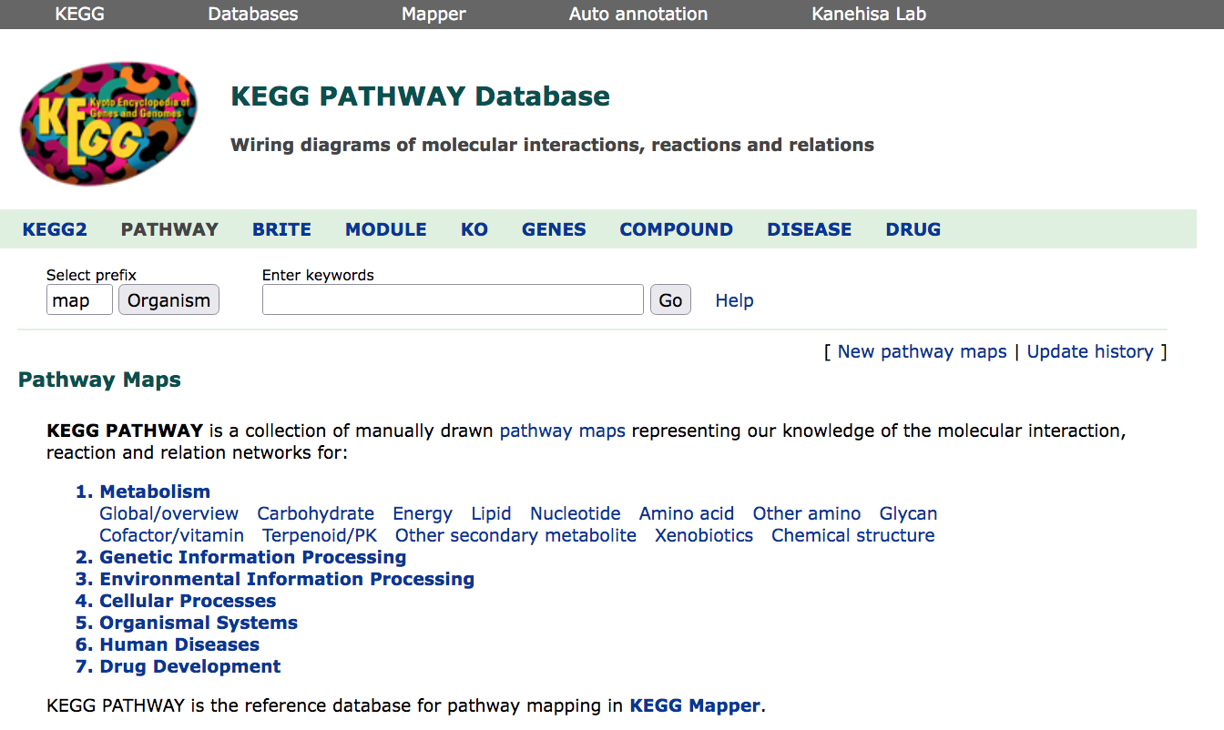
KEGG
https://www.genome.jp/kegg/pathway.html
Notes:
KEGG is a database resource for understanding high-level functions and utilities of the biological system, such as the cell, the organism and the ecosystem, from genomic and molecular-level information. It is a computer representation of the biological system, consisting of molecular building blocks of genes and proteins (genomic information) and chemical substances (chemical information) that are integrated with the knowledge on molecular wiring diagrams of interaction, reaction and relation networks (systems information). It also contains disease and drug information (health information) as perturbations to the biological system.
The KEGG database has been in development by Kanehisa Laboratories since 1995, and is now a prominent reference knowledge base for integration and interpretation of large-scale molecular data sets generated by genome sequencing and other high-throughput experimental technologies.

Slide 47
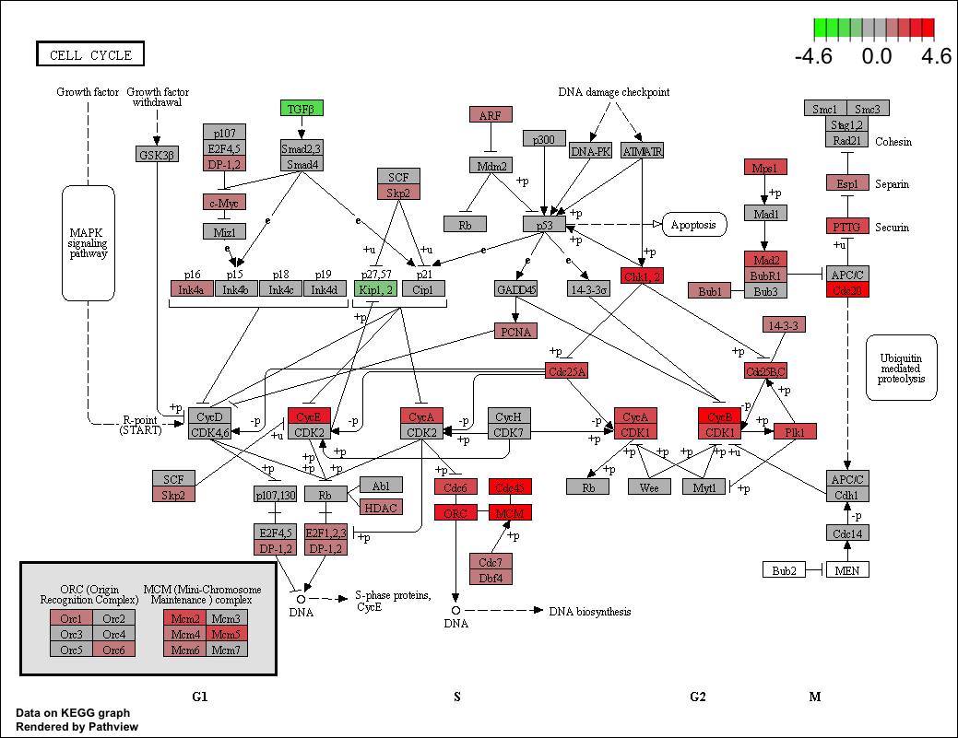
Visualization for KEGG pathways pathview package
> pathview(gene.data = geneList, pathway.id = "hsa04110", species = "hsa",
limit = list(gene=max(abs(geneList)), cpd=1))
Notes:
Pathview is a tool set for pathway-based data integration and visualization. It maps and renders a wide variety of biological data on relevant pathway graphs. All users need is to supply their data and specify the target pathway. Pathview automatically downloads the pathway graph data, parses the data file, maps user data to the pathway, and render pathway graph with the mapped data. In addition, Pathview also seamlessly integrates with pathway and gene set (enrichment) analysis tools for large-scale and fully automated analysis.

Slide 48
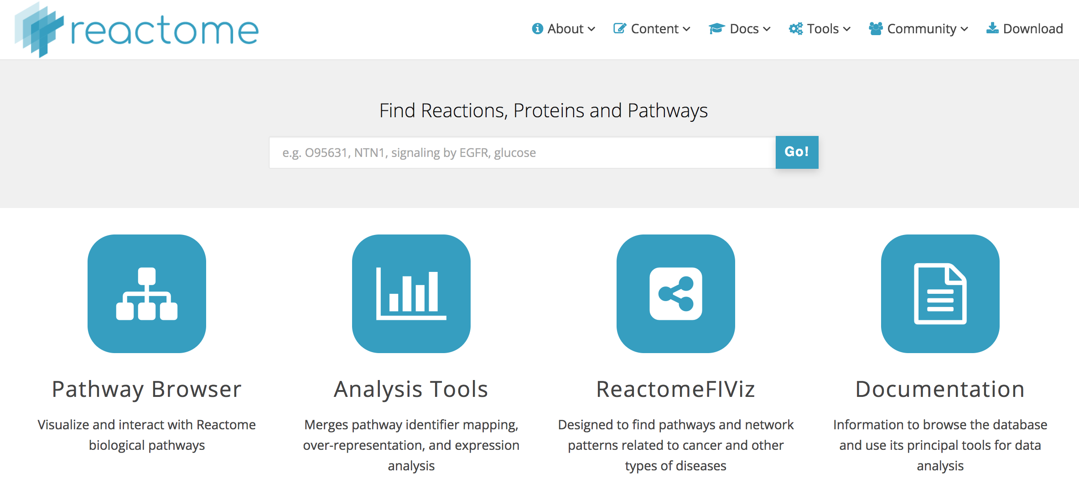
Reactome
https://reactome.org/
Notes:
REACTOME is an open-source, open access, manually curated and peer-reviewed pathway database. Our goal is to provide intuitive bioinformatics tools for the visualization, interpretation and analysis of pathway knowledge to support basic and clinical research, genome analysis, modeling, systems biology and education. Founded in 2003, the Reactome project is led by Lincoln Stein of OICR, Peter D’Eustachio of NYULMC, Henning Hermjakob of EMBL-EBI, and Guanming Wu of OHSU.

Slide 49
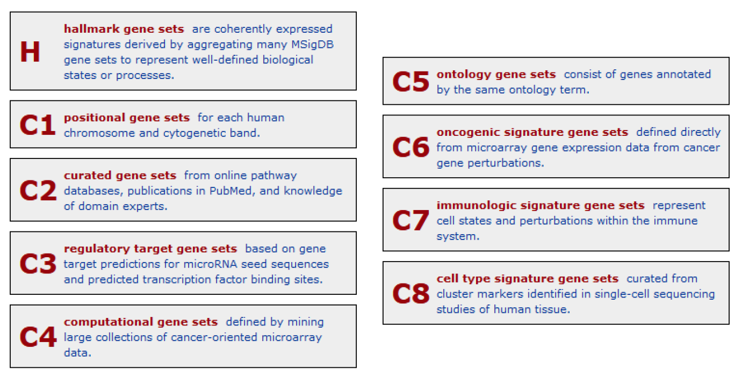
MSigDB
https://www.gsea-msigdb.org/gsea/msigdb/index.jsp
Download gmt files with version number:
https://www.gsea-msigdb.org/gsea/downloads.jsp
The Hallmark collection:
https://www.ncbi.nlm.nih.gov/pmc/articles/PMC4707969/
Notes:
The Molecular Signatures Database (MSigDB) hallmark gene set collection
Arthur Liberzon,¹ Chet Birger,¹ Helga Thorvaldsdóttir,¹ Mahmoud Ghandi,¹ Jill P. Mesirov,^{1,2,3,4,*} and Pablo Tamayo^{1,2,3,4,*,1}
Cell Syst. 2015 Dec 23; 1(6): 417–425.
The Molecular Signatures Database (MSigDB) is one of the most widely used and comprehensive databases of gene sets for performing gene set enrichment analysis. Since its creation, MSigDB has grown beyond its roots in metabolic disease and cancer to include >10,000 gene sets. These better represent a wider range of biological processes and diseases, but the utility of the database is reduced by increased redundancy across, and heterogeneity within, gene sets. To address this challenge, here we use a combination of automated approaches and expert curation to develop a collection of “hallmark” gene sets as part of MSigDB. Each hallmark in this collection consists of a “refined” gene set, derived from multiple “founder” sets, that conveys a specific biological state or process and displays coherent expression. The hallmarks effectively summarize most of the relevant information of the original founder sets and, by reducing both variation and redundancy, provide more refined and concise inputs for gene set enrichment analysis.

Slide 50
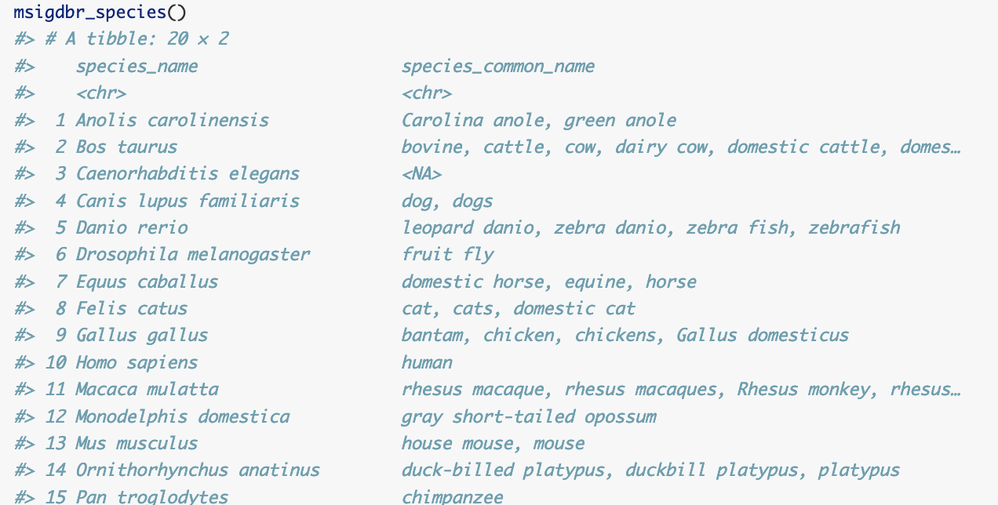
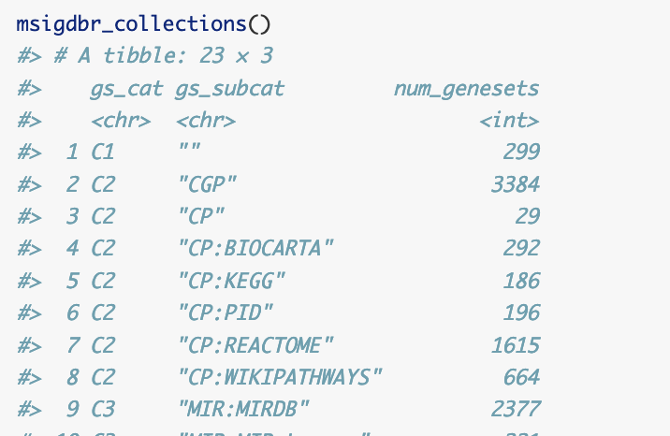
msigdbr package
Homologues for other species
Helper function to view
available collections
https://cran.r-project.org/web/packages/msigdbr/index.html

Slide 51
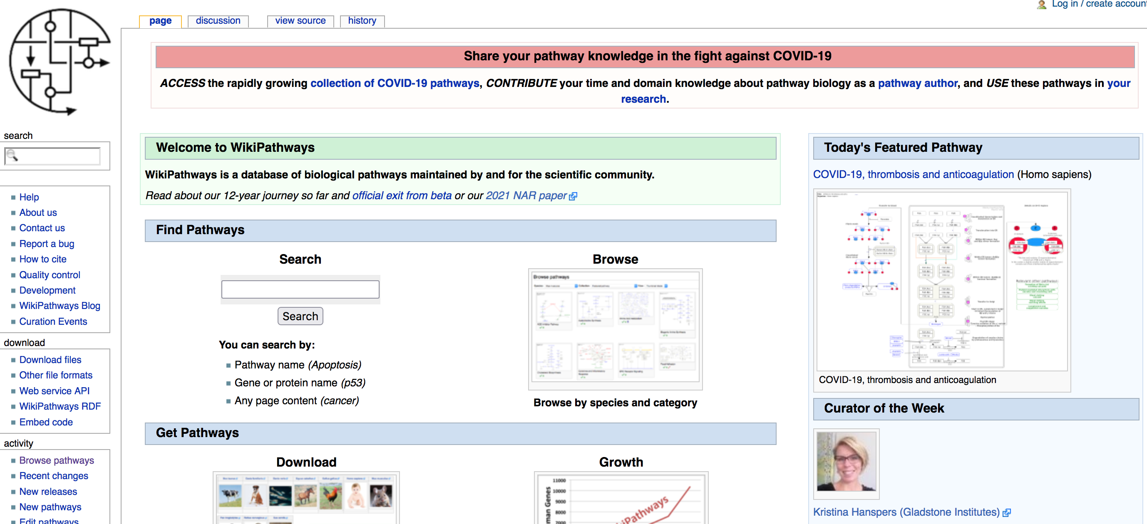
WikiPathways
https://www.wikipathways.org/index.php/WikiPathways
Notes:
WikiPathways was established to facilitate the contribution and maintenance of pathway information by the biology community. WikiPathways is an open, collaborative platform dedicated to the curation of biological pathways. WikiPathways thus presents a new model for pathway databases that enhances and complements ongoing efforts, such as KEGG, Reactome and Pathway Commons. Building on the same MediaWiki software that powers Wikipedia, we added a custom graphical pathway editing tool and integrated databases covering major gene, protein, and small-molecule systems. The familiar web-based format of WikiPathways greatly reduces the barrier to participate in pathway curation. More importantly, the open, public approach of WikiPathways allows for broader participation by the entire community, ranging from students to senior experts in each field. This approach also shifts the bulk of peer review, editorial curation, and maintenance to the community.

Slide 52
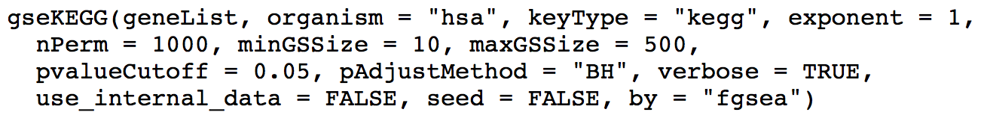



GSEA of other gene sets in R
KEGG: ClusterProfiler built-in function for GSEA of KEGG pathways
User-defined gene set collection: Import a .gmt file of gene sets and convert to TERM2GENE data frame needed for clusterProfiler:
Converts a gmt text file with 1 gene set per line to a 2-column data frame:
Conversion of gene ID types with clusterProfiler (or biomaRt package)
biomaRt: https://bioconductor.org/packages/release/bioc/html/biomaRt.html

Slide 53
Recap and exercise 4
We have seen how to perform GSEA using the built-in GO gene sets. Please perform GSEA with the built-in KEGG pathways, as well as with the hallmark gene sets obtained from MSigDB.
Exercise 4: use functions of clusterProfiler and data provided in Ex. 1, and hallmark gene sets downloaded from MSigDB
First convert the gene symbols to EntrezID, then perform a GSEA of KEGG pathways (with argument minGSSize=30).
Explore the results. Is there an immune-related gene set coming up? Is there a Natural killer gene set coming up?
Using msigdbr, obtain a TERM2GENE data.frame of the Hallmark gene sets and run a GSEA. How many significant gene sets are there?

Slide 54

Enrichment/functional analysis - summary

Slide 55

Functional analysis: Pathway topology tools
Signaling pathway impact analysis (SPIA)
Identification of dys-regulated pathways: taking into account gene interaction information + fold changes and adjusted p‐values from differential expression analysis
https://bioconductor.org/packages/release/bioc/html/SPIA.html

Slide 56

Single-sample gene set variation analysis
GSVA: https://bioconductor.org/packages/release/bioc/html/GSVA.html
https://www.jci.org/articles/view/129558
Notes:
Colorectal cancer samples.
GSVA calculates a per-sample and per gene set enrichment score, that can be used for correlations with gene expression, survival analysis grouping samples into high and low enrichment scores, etc

Slide 57
Credits: 0.25 ECTS
Please provide answers and R code for an additional exercise (eg 1 Word with answers and figures and 1 script file, or 1 file generated from Rmarkdown)
https://sib-swiss.github.io/enrichment-analysis-training/exercises/#extra-exercise-for-ects-credits
Sign up for credit by adding your name to the google Doc file (email sent by course organizer)
Send answers to tania.wyss@sib.swiss within 1 week

Slide 58

Thank you for your attention!
Please fill in the feedback sent by the course organizer.
We thank Isabelle Dupanloup and Linda Dib for
providing course material.

Slide 60
Limitations of enrichment analysis
On the influence of several factors on pathway enrichment analysis
https://academic.oup.com/bib/article/23/3/bbac143/6572658
Urgent need for consistent standards in functional enrichment analysis
https://journals.plos.org/ploscompbiol/article?id=10.1371/journal.pcbi.1009935

Slide 61
Enrichment analysis in non-model organisms – some tools/code
A pipeline for non-model Scots pine: Starting from transcriptome assembly, gene annotation and enrichment of Gene Ontology collection.
eggNOG: https://academic.oup.com/nar/article/47/D1/D309/5173662
Some code for EA for non-model species: https://archetypalecology.wordpress.com/2021/01/27/how-to-perform-kegg-and-go-enrichment-analysis-of-non-model-species-using-r/
.

Slide 62
Proteomics
Bioinformatic analysis of proteomics data
https://bmcsystbiol.biomedcentral.com/articles/10.1186/1752-0509-8-S2-S3
Knowledge-based analysis of proteomics data
https://bmcbioinformatics.biomedcentral.com/articles/10.1186/1471-2105-13-S16-S13
GO Enrichment Analysis for Differential Proteomics Using ProteoRE
https://pubmed.ncbi.nlm.nih.gov/34236662/

Slide 63

Bioconductor
GO.db : A set of annotation maps describing the entire Gene Ontology assembled using data from GO
gskb: mouse
KEGG.db: A set of annotation maps for KEGG assembled using data from KEGG

Slide 64
Note on gene ID conversion
When converting, not all genes have a matching ID type, or some genes have duplicated IDs (eg symbols).
A good idea is to obtain EnsembI ID-to-symbol conversion for your reference genome version:
Download gtf from Ensembl: http://www.ensembl.org/index.html
ftp://ftp.ensembl.org/pub/release-100/gtf/homo_sapiens/
Download as a data frame with refGenome package (archived)
https://cran.r-project.org/web/packages/refGenome/index.html

Slide 65


Differential gene expression analysis
Comparing 2 groups:
For each gene i, is there a difference in expression between control and patients?
Fold change in genomics:
log₂ of ratios = log fold change
log(πi1/πi2) = log(πi1) - log(πi2)
healthy
donors
patients
Diff. expressed
sort
logFC
Not diff. expressed

Slide 66


Typical RNA sequencing analysis workflow
fastq file:
Filter quality
Align to ref. genome
count reads
per gene
Downstream statistical analysis:
R: import
counts table

Slide 67

Some additional resources

